Slide 1
DATA WAREHOUSING
-Heena Rijhwani

Slide 2
Data Extraction and Dataset description
1. Data on Brazilian Ecommerce Store, Olist
2. Extracted from Kaggle
3. 100,000 orders from 2016 to 2018
4. Seven csv files on:
Customer location (zipcode, city, state)
Seller location (zipcode, city, state)
Products (dimensions such as height, width, length and width, product category)
Order details (order status, order purchased timestamp, approved timestamp, delivered timestamp, estimated delivery date)
Order reviews (review score, comments title and message, review creation and answer date)
Order payments (payment type and value)
Order items (product id, seller id, freight value, product price and shipping date of every product in each order)

Slide 3
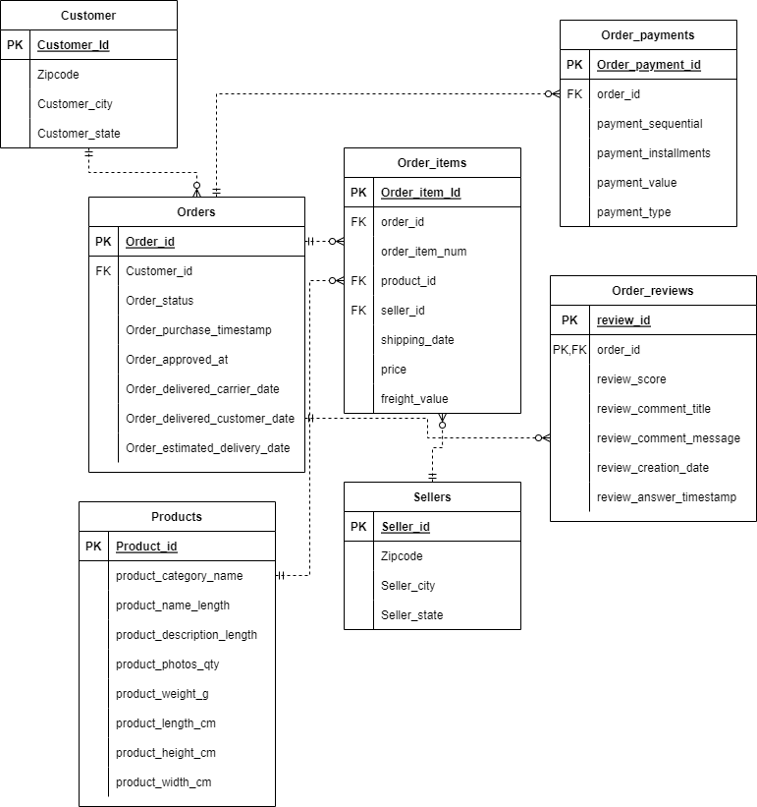
Entity Relation Diagram Loading the data into tables
Creating the table with appropriate datatypes for each attribute
CREATE TABLE CUSTOMER
(
CUSTOMER_ID VARCHAR(50),
CUSTOMER_UNIQUE_ID VARCHAR(50),
ZIPCODE NUMERIC(16),
CUSTOMER_CITY VARCHAR(50),
CUSTOMER_STATE VARCHAR(10),
CONSTRAINT CustomerId_PK PRIMARY KEY (Customer_Id);
Inserting data into table from the csv file
COPY Customer(Customer_Id,Customer_Unique_Id,Zipcode,Customer_City,Customer_State)
FROM 'C:\Users\heena\OneDrive\Desktop\CS 779\Project\data\olist_customers_dataset.csv’ –file path
DELIMITER ','
CSV HEADER;
Retrieving data from table to check if it has been loaded
Select * from Customer limit 5;

Slide 4
Adding Constraints Primary Key Constraints
Setting customer_id, product_id and order_id as Primary Key for Customer, Orders and Product tables respectively
Adding synthetic PK to Order_items table using Serial (order_item_id)
Adding synthetic PK to Payments table using Sequence (order_payments_id)
Setting composite PK for Order_reviews (review_id,order_id)
Foreign Key Constraints to link all entities
Order_items references Orders, Products and Sellers tables via order_id, product_id and seller_id respectively. For instance,
ALTER TABLE order_items
ADD CONSTRAINT order_id_fk FOREIGN KEY (order_id) REFERENCES Orders(order_id);
Orders references Customer via customer_id as FK
Order_payments and Order_reviews reference Orders via order_id as FK

Slide 5
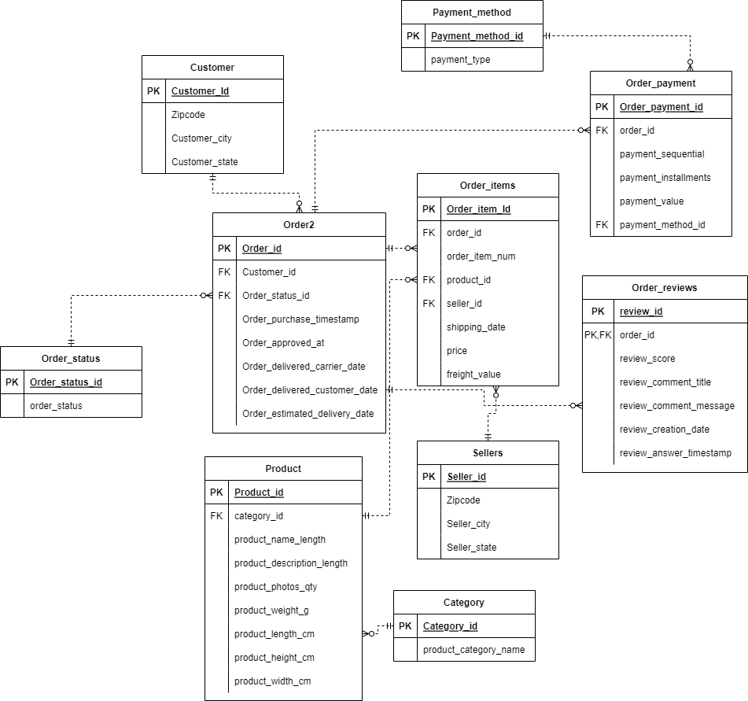
Normalizing the schema
Normalizing payment type attribute of Order_payment table (credit card, voucher, debit card etc.)
Creating a separate table for payment methods, mapping each unique method to an id
Creating a new normalized table by replacing payment type by payment method id
Inserting values into new normalized table by joining old Order_payment table and newly created paymentmethod table
Again adding PK and FK constraints to all entities the Order payment table references or is referenced by, including payment method table I just created
Similarly normalizing order_status attribute of Orders table (delivered, invoiced, shipped etc. categories)
Normalizing product_category attribute of Products table
--Creating a separate table for payment methods
--Mapping each unique method to an id

Slide 6
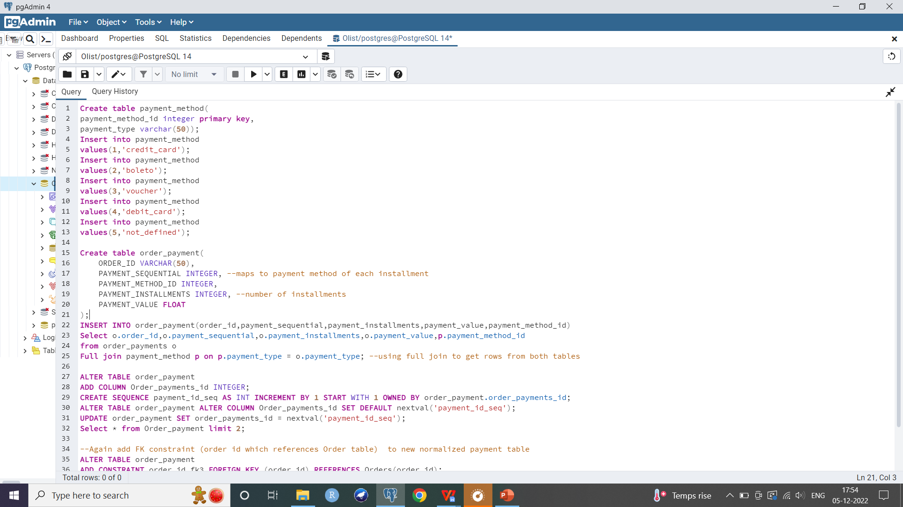
Normalizing the schema
Creating a table mapping each unique value of the attribute to be normalized to an id
Creating normalized table by replacing the attribute with synthetic id as FK (for example, product_category_name is replaced by category_id which references the Category table)
Joining both tables and inserting into new normalized table (for example, join old Products and Category to give new Product table)
Adding Primary Key constraints (add product_id as PK)
Re-enforcing all FK constraints (category_id from Product table to reference the Category entity; product_id from Order_items table to reference new Product entity)

Slide 7
Data Pre-processing and Transformation
Dropping redundant column customer_unique_id since I already have customer_id PK which is unique
Checking for null values:
a. Retained null values in text fields (such as review title and comments)
b. Retained null values in carrier delivery and customer delivery dates (orders still in transit)
c. 610 null values found in photos_qty attribute of Product table. I replaced these with the mean of the column
SELECT AVG(product_photos_qty)
FROM product; --2
UPDATE product SET product_photos_qty= 2 WHERE product_photos_qty IS NULL;
d. Similarly replacing 2 null values in product weight, height, width and length by means of respective columns
Adding new attribute total_transportation_cost to order items table (number of items per order*freight value per item)
Adding check constraint on review score so that only a score between 1 to 5 can be entered for all future data
Dropping columns which are not needed (product name length and product description length)
Renaming certain columns

Slide 8
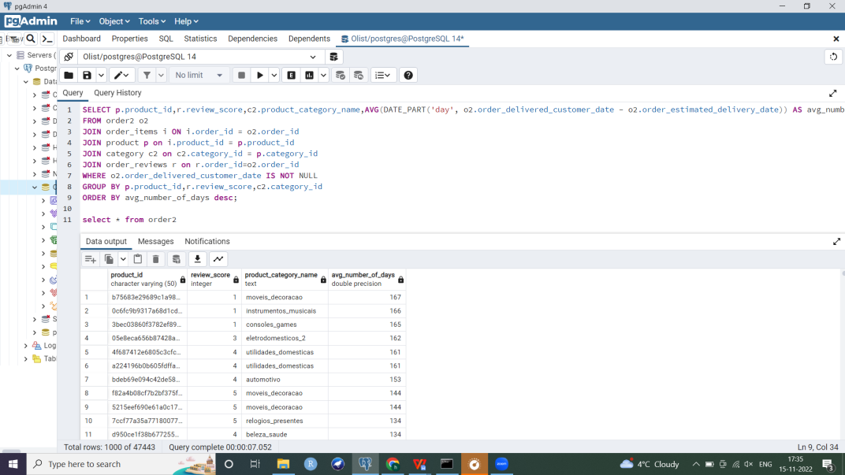
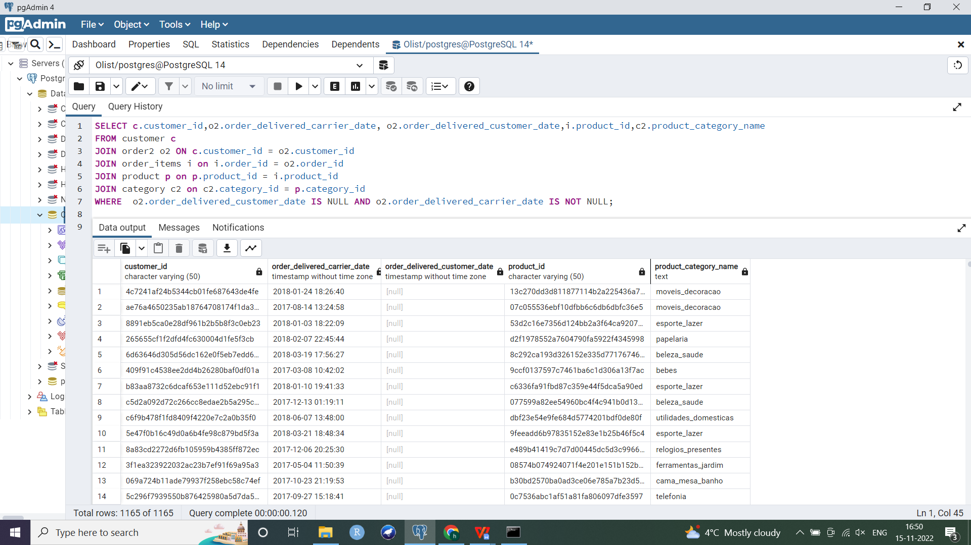
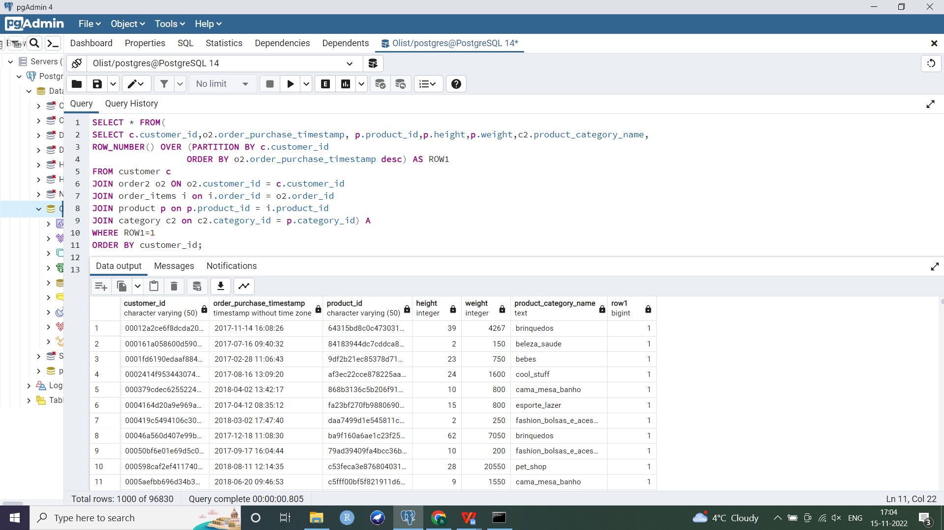
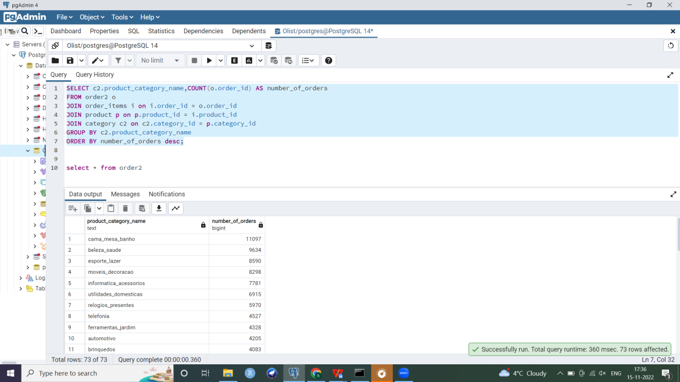
Data Exploration using OLTP queries
Retrieving records for products which are in transit, i.e. they have been delivered to the carrier or shipped but not yet delivered to the customer (INNER JOIN, IS NULL)
Average delay in delivery per product, i.e. the average difference between estimated delivery day and the actual day when order reached the customer (Aggregates, date functions)
Retrieving records for most recent orders placed by customers (Window function, Subquery)
How many times have products of each category been bought? (aggregate functions)

Slide 9
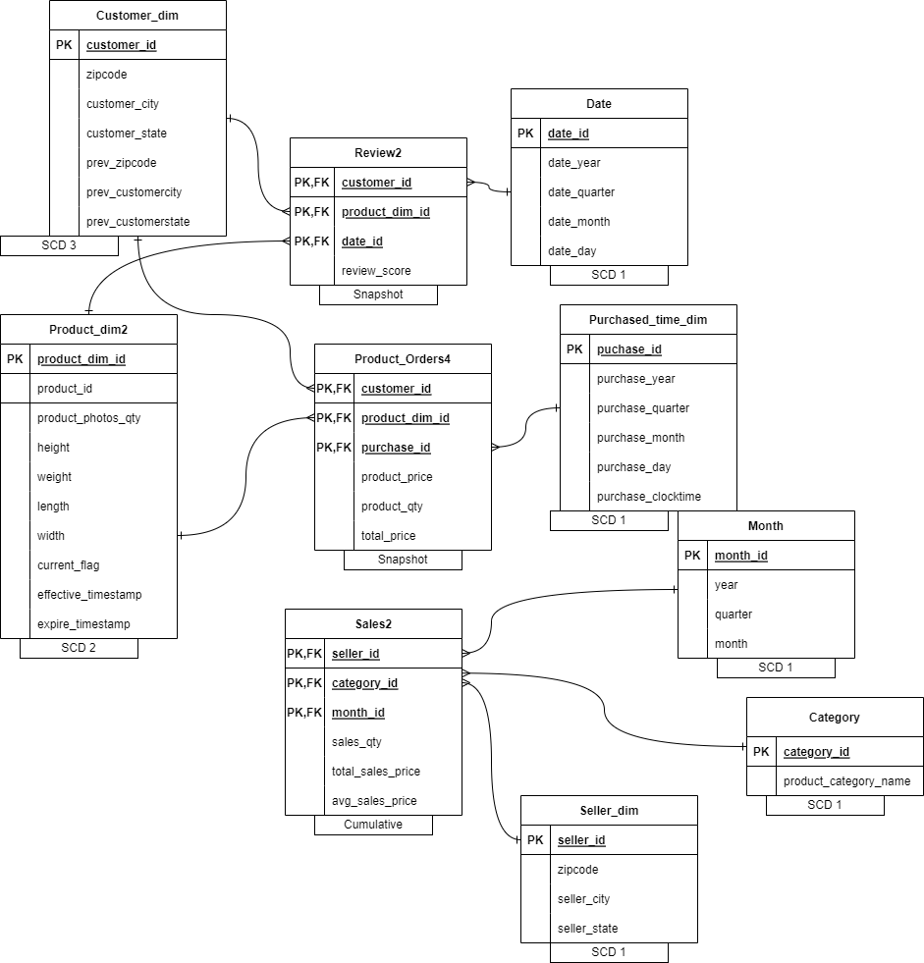
Constellation Dimensional Schema
Fact tables: Review2, Product_Orders4,
Sales2
Dimensions:
1. SCD1:
Seller_dim,
Date,
Month,
Purchased_time_dim,
Category
2. SCD2:
Product_dim2
3. SCD3:
Customer_dim

Slide 10
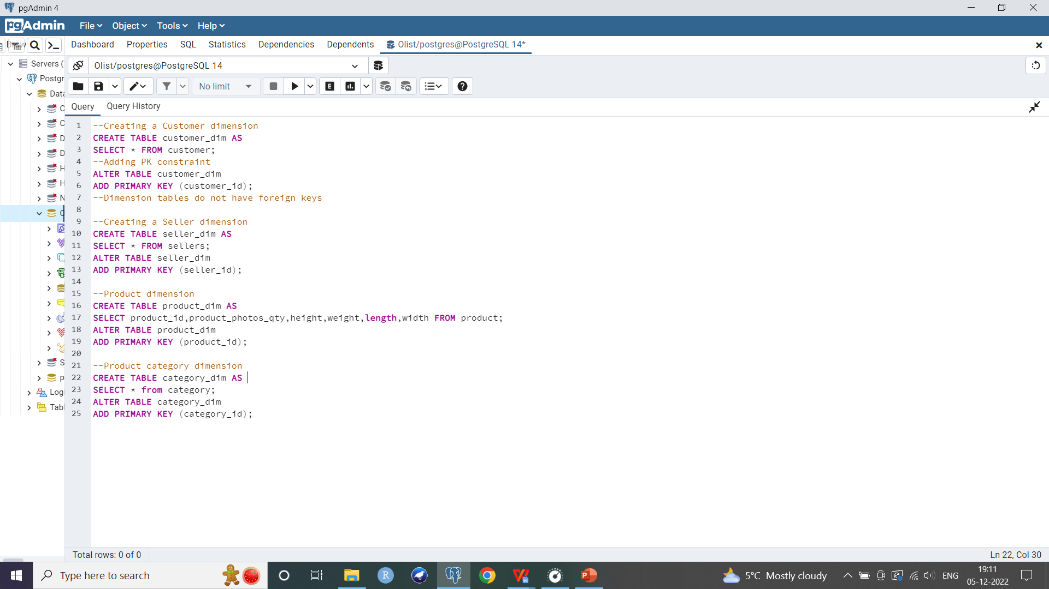
Transformation: Constellation Dimensional Schema Multiple dimension and fact tables
Creating dimensional schema from normalized design since some entities from my normalized schema such as product category were an important aspect of dimensional schema and were relevant to answering business questions
Creating dimension tables and adding PK (no FK constraints)
-- Customer, Seller, Product and Product_category dimensions
Creating 3 date/ time dimensions:
a. Purchase time dimension represents when the product was purchased/
when order was placed (derived from order_purchased_ts)
b. Date dimension represents when each review was created (derived
From review_creation_ts)
c. Month dimension represents when the product was purchased
similar to the purchased_time dimension but at a lower level of granularity
(derived from order_purchased_ts)

Slide 11
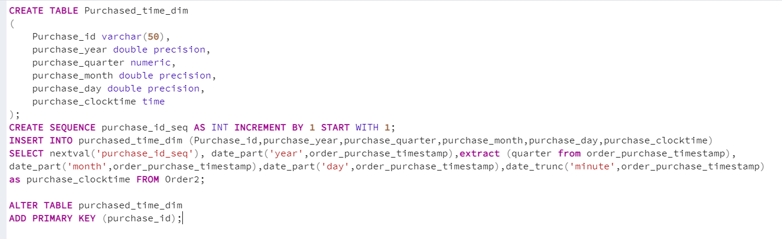
Dimension tables
Steps for creating time dimensions:
1. Create table with required level of granularity. Here, Purchased_time dimension is at a higher level of granularity (year, quarter, month, day, clocktime) as compared to my Month and Date dimensions
2. Adding synthetic PK using sequence
3. Separating parts of purchase timestamp from the Orders table into new time dimension: date_part() to extract year, month and day; extract() to get the quarter and date_trunc() for clocktime attribute of the purchased time dimension
4. Similarly for other 2 time dimensions

Slide 12
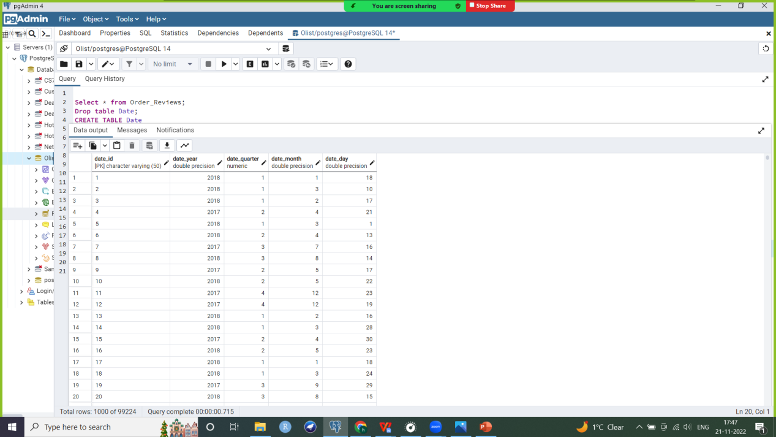
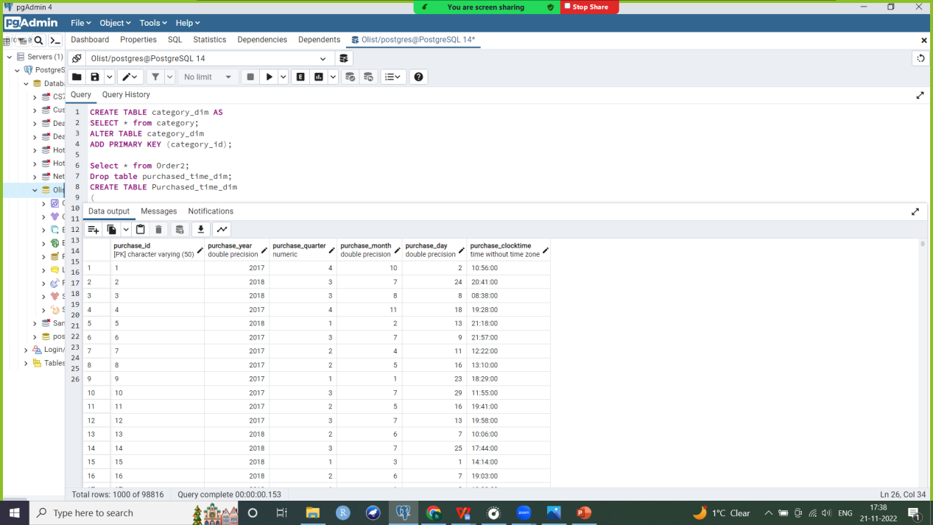
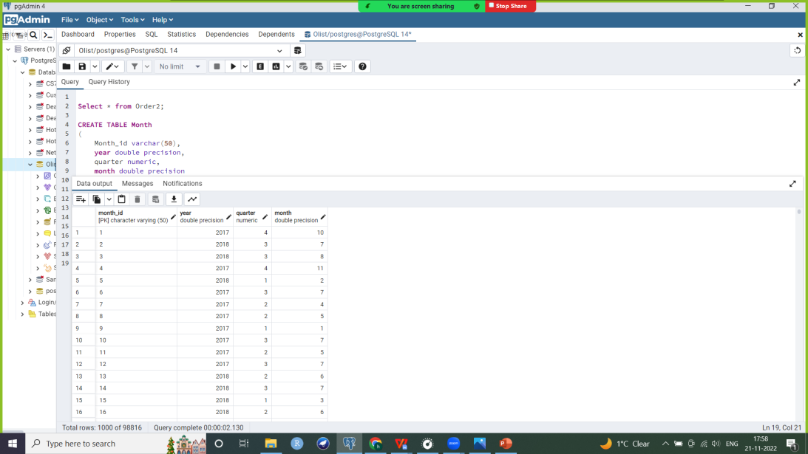
Time dimensions
Date dimension
Purchased time dimension
Date and Month
dimensions

Slide 13
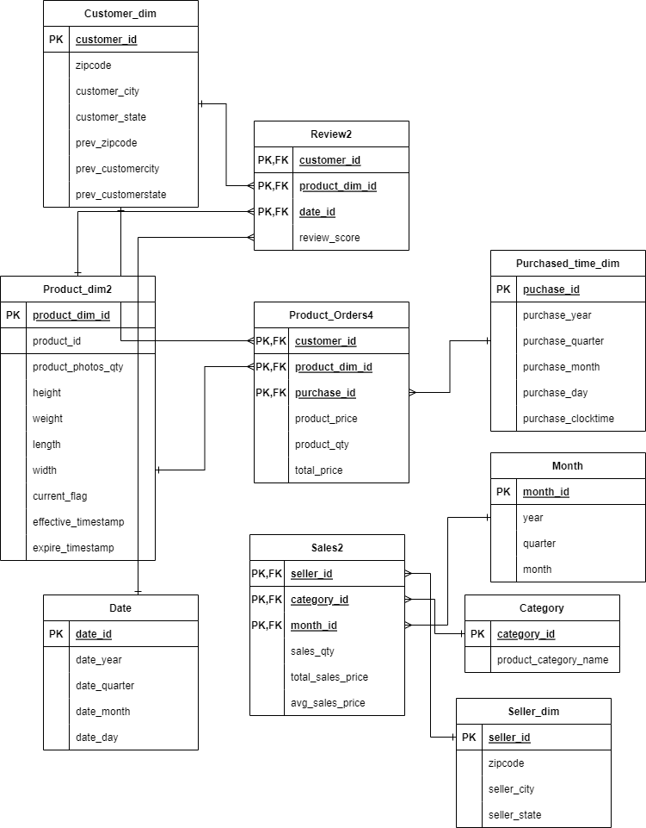
Fact tables
1. Review
Snapshot fact table
Contains 3 foreign keys referencing the Customer, Product and Date dimensions, which also form a composite PK
Contains review score measure
Represents review score by product by customer at a particular instant
Creating the fact table:
a. Joining dimension tables and inserting into new Review fact table
CREATE TABLE Review as
Select c.customer_id, o.order_id, p.product_id, r.review_score,
d.date_id from Customer c
join Order2 o on c.customer_id = o.customer_id
join Order_items i on i.order_id = o.order_id
join Product p on p.product_id = i.product_id
join Order_reviews r on r.order_id = i.order_id
join Date d on d.date_id=r.date_id;
b. Deleting duplicate records from Review fact table
c. Dropping order_id attribute which is not needed
d. Adding composite PK and 3 FK constraints to reference dimension tables

Slide 14
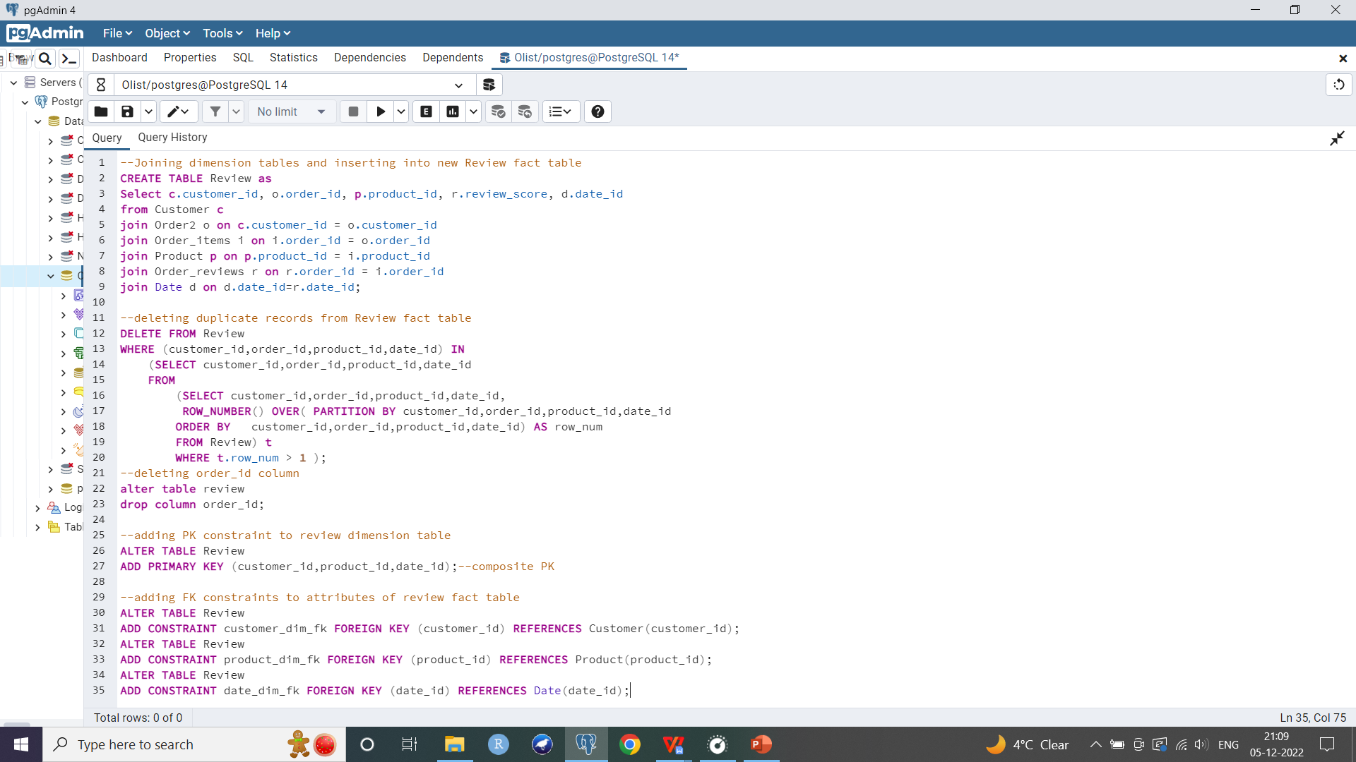
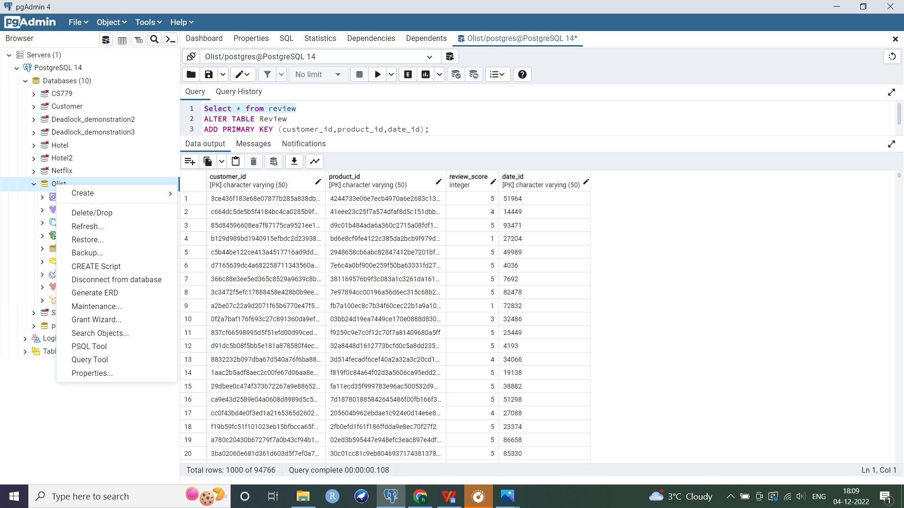
Fact tables
Review fact table

Slide 15
Fact tables
2. Product_Orders
Snapshot fact table
3 foreign keys referencing the Customer, Product and Purchased time dimensions
+ composite PK
Contains 3 measures: number of purchases of a particular product by a customer at a certain instant, average cost per product in a purchase, and total price per purchase by a customer at a certain time
Creating the fact table:
a. Joining dimension tables and inserting into new Product Orders fact table
b. Adding a column of count/ number of purchases of a particular product by a customer at a certain instant using group by. Creating new table Product_Orders3 with these counts (this table has lesser number of rows since we aggregated purchases by customer, by product, by time)
c. Adding the average cost per product in a purchase by a customer at a certain time
d. Adding total price column (product quantity * average price per product in a purchase)
e. Adding composite PK and 3 FK constraints to reference dimension tables

Slide 16
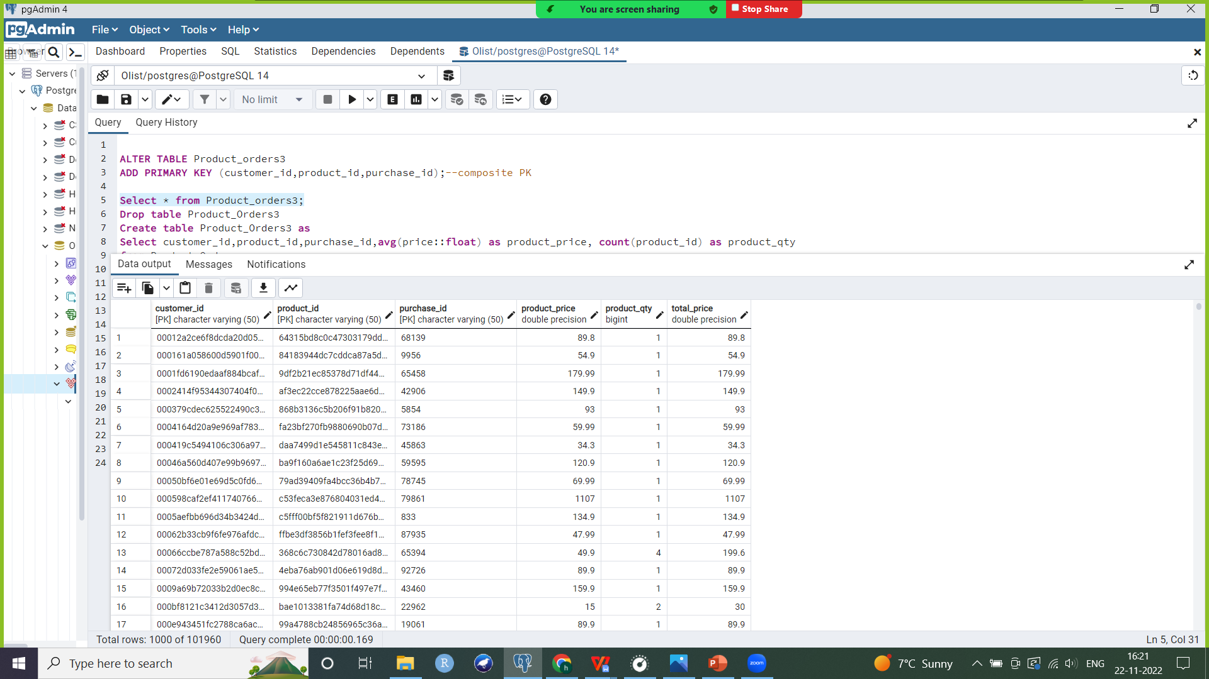
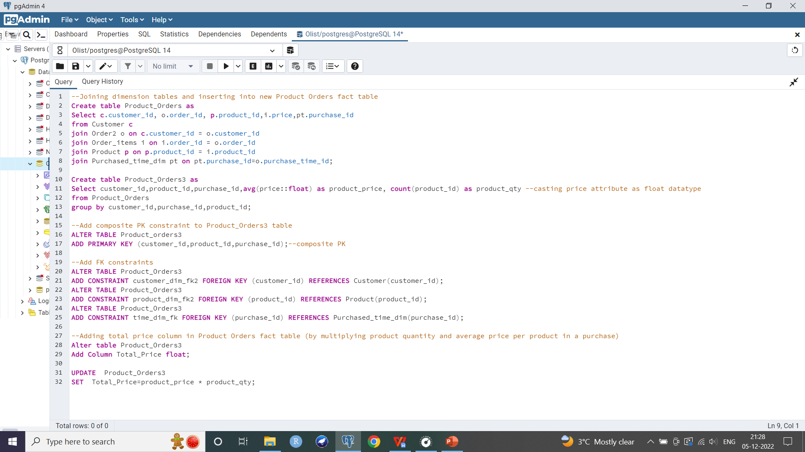
Fact tables
Product Orders fact table

Slide 17
Fact tables
3. Sales
Cumulative fact table
References the seller, product category and month of purchase dimensions
Includes measures: count of sales, average price and total earnings by product category by seller by month
Creating the fact table:
a. Joining dimension tables
b. Computing count of sales and average price per product category by a seller in a month using group by
c. Adding total sales price measure (average price*count of sales)
d. Adding PK, FK constraints

Slide 18
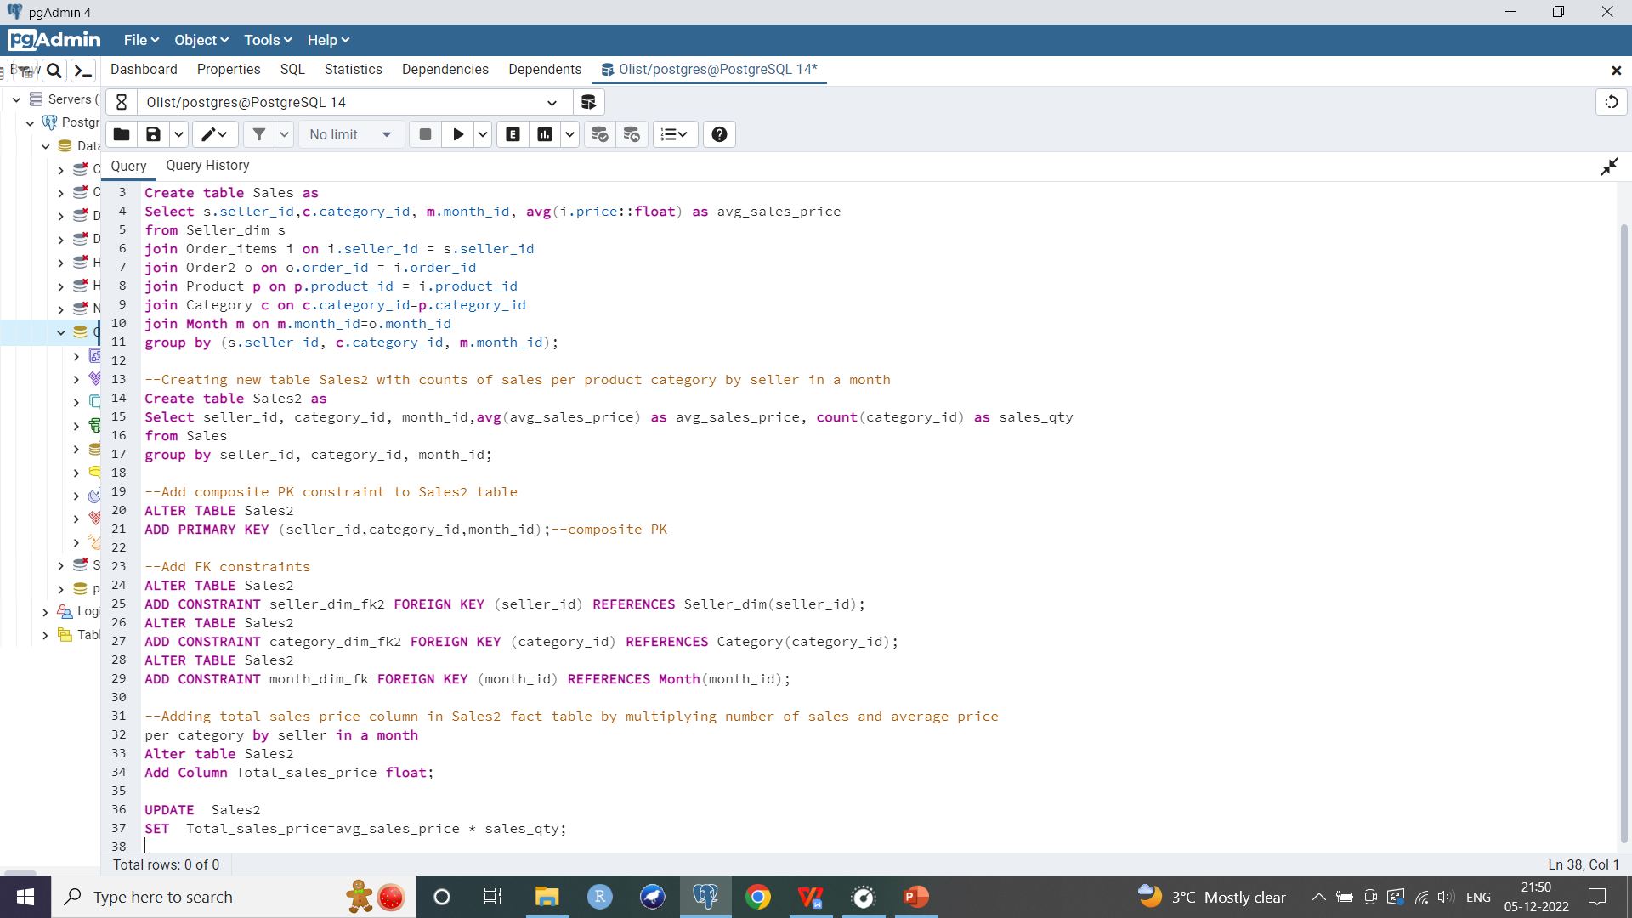
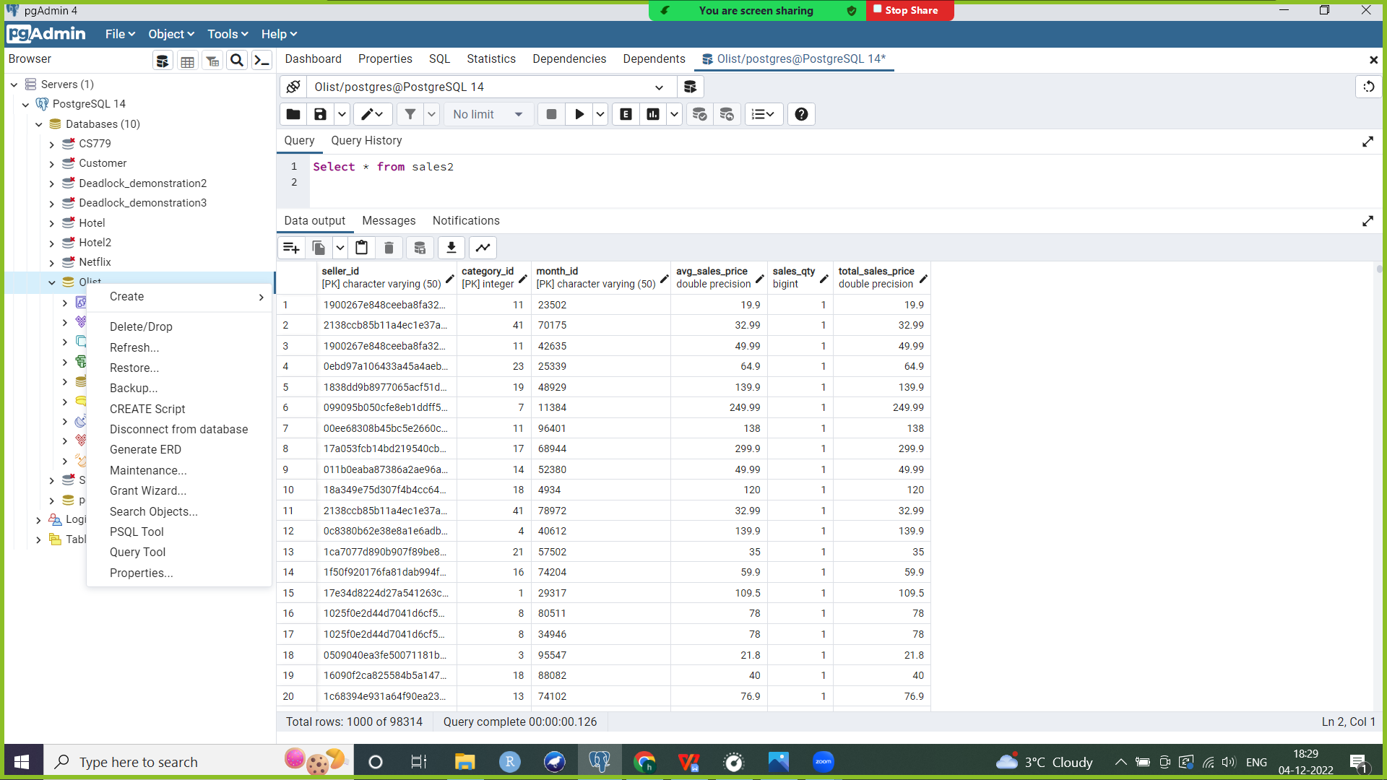
Fact tables
Sales fact table

Slide 19
Maintaining Slowly Changing Dimensions
SCD 1: Seller dimension, Month dimension, Date dimension, Purchased_time dimension, Category dimension
These dimensions are SCD1 since their values change infrequently and Olist is not particularly interested in recording old vs new values
Steps:
a. Creating staging table for seller dimension which will load the incremental changes that come from the source system. Staging table will not have a PK
b. Creating a stored procedure which inserts a new record into the staging table. It then compares if a record with the same PK (seller_id) exists in the corresponding dimension table. If not, it simply inserts this record into the dimension table
c. If matching PK was found (i.e. if seller_id in input parameters which I am inserting into staging table matches an already existing record in the dimension table), then update values of that record in the dimension table

Slide 20
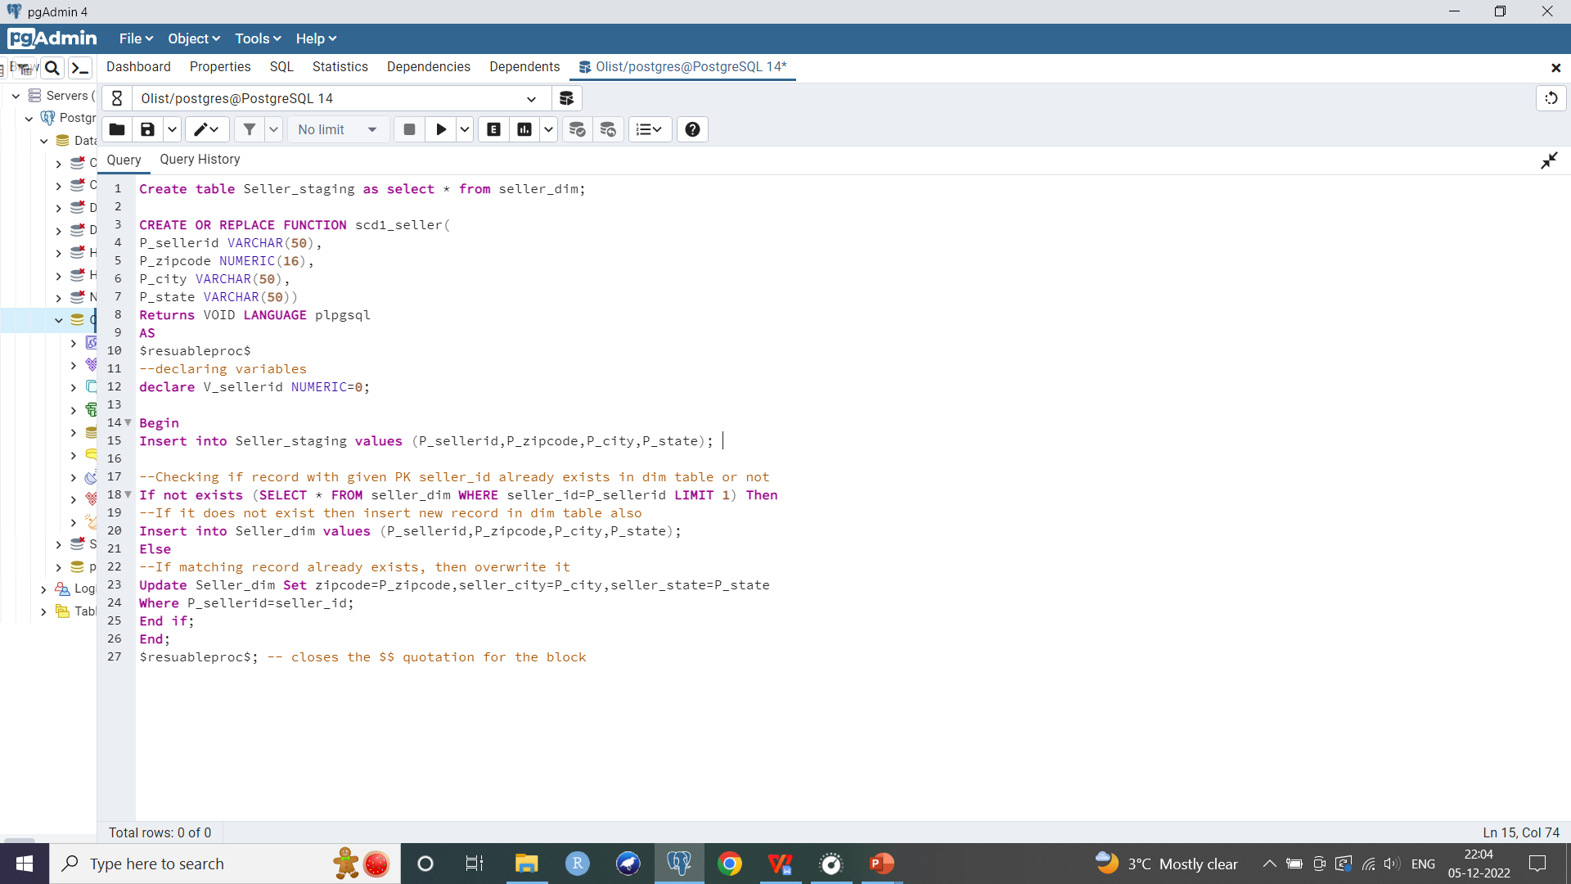
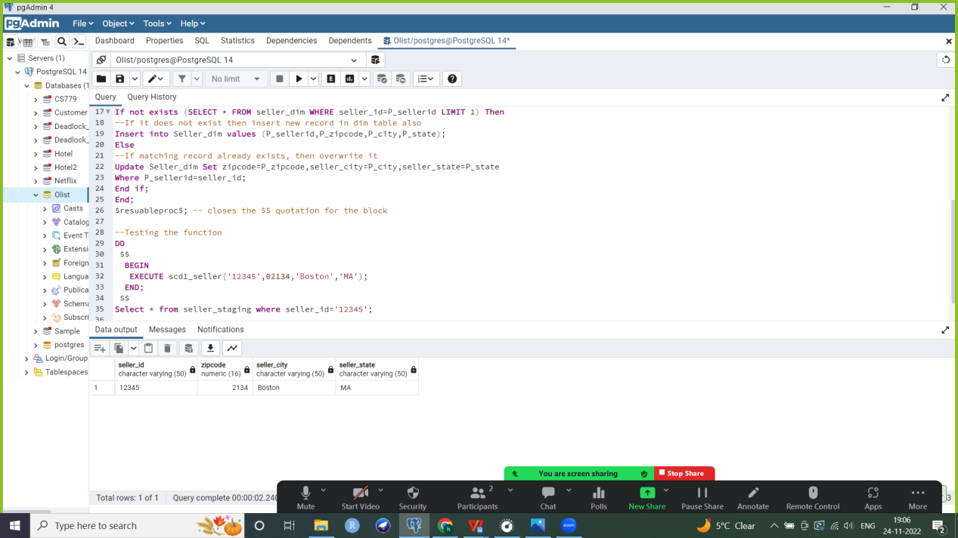


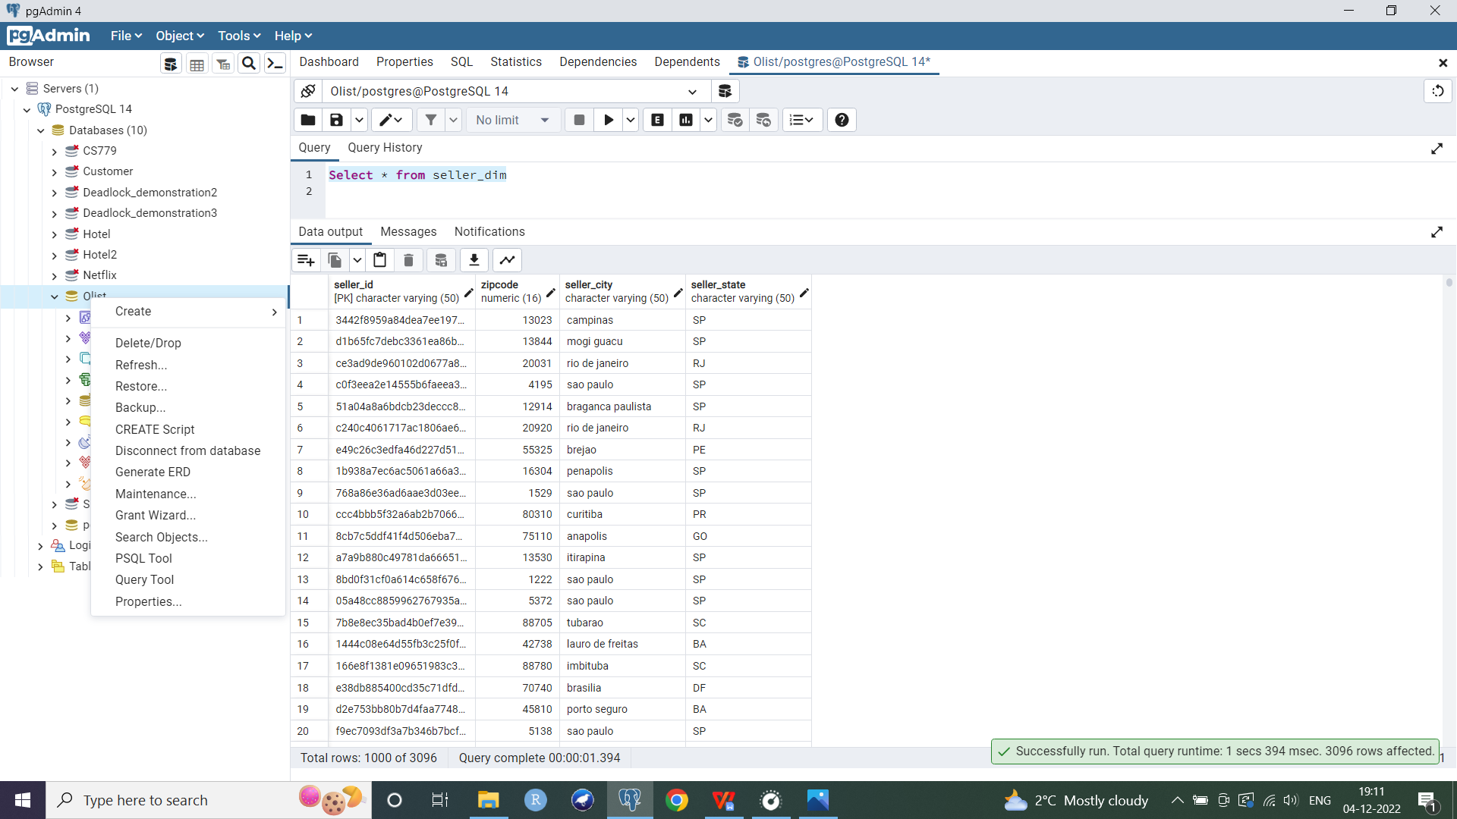
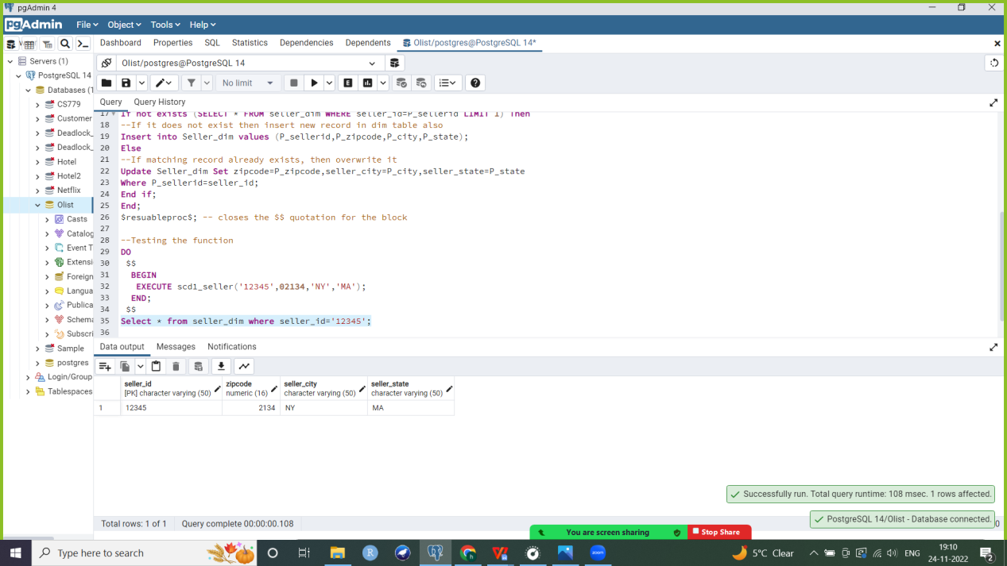
Maintaining SCD1: Seller
Testing the function
Case 1: Record does not match
DO
$$
BEGIN
EXECUTE scd1('12345',02134,'Boston','MA');
END;
$$
Select * from seller_staging where seller_id='12345’;
--record inserted in staging table
Select * from seller_dim where seller_id=’12345’;
--record inserted in dimension table
Case 2: Record does match
DO
$$
BEGIN
EXECUTE scd1_seller('12345',02134,'NY','MA');
END;
$$
Select * from seller_staging where seller_id='12345’;
--record inserted in staging table
Select * from seller_dim where seller_id='12345’;
--record updated in dimension table
Seller dimension

Slide 21
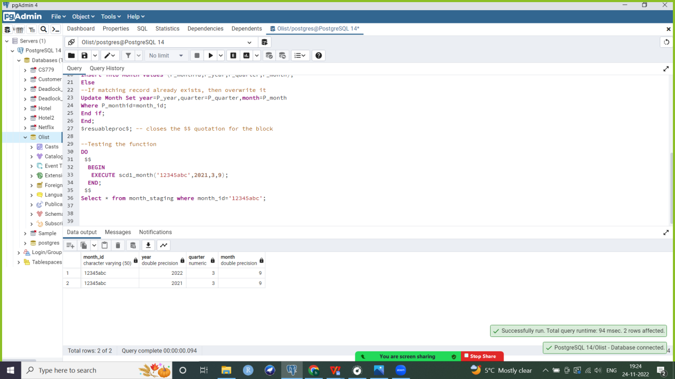
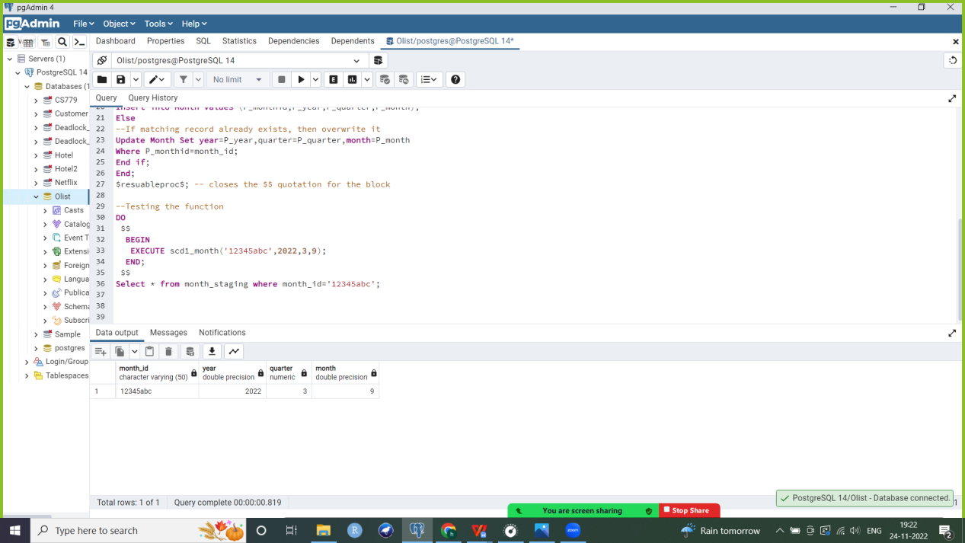

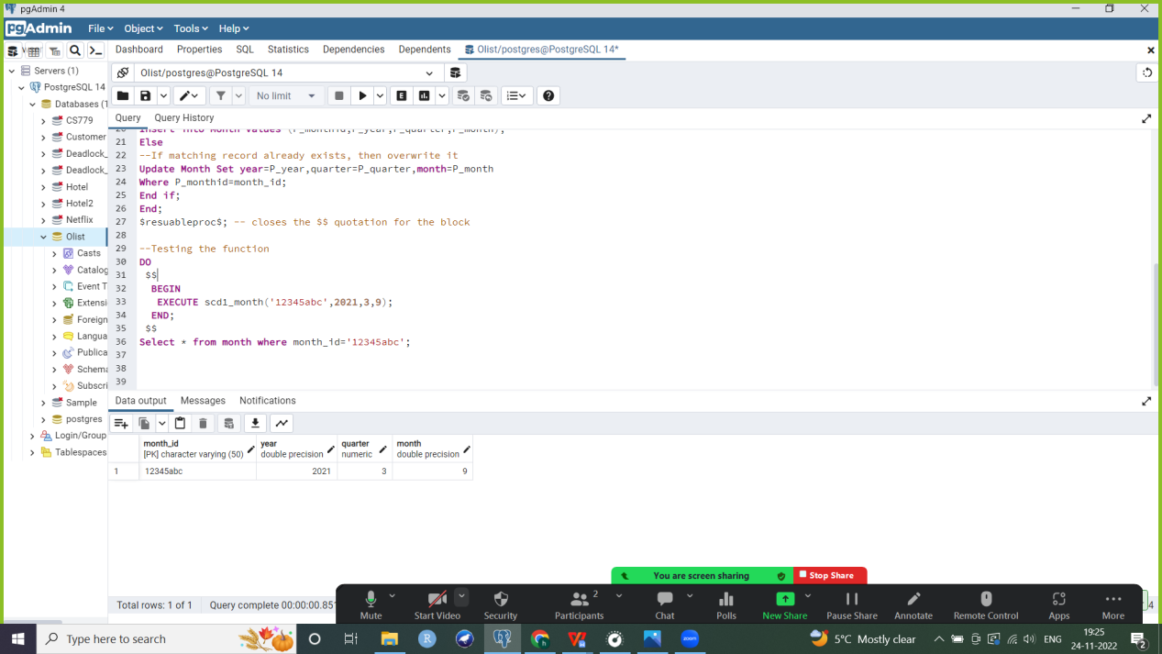
Maintaining SCD1: Month
Testing the function
Case 1: Record does not match
DO
$$
BEGIN
EXECUTE scd1_month('12345abc',2022,3,9);
END;
$$
Select * from month_staging where month_id='12345abc';
--record inserted in staging table
Select * from month where month_id='12345abc';
--record inserted in dimension table
Case 2: Record does match
DO
$$
BEGIN
EXECUTE scd1_month('12345abc',2021,3,9);
END;
$$
Select * from month_staging where month_id='12345abc';
--record inserted in staging table
Select * from month where month_id='12345abc';
--record updated in dimension table

Slide 22
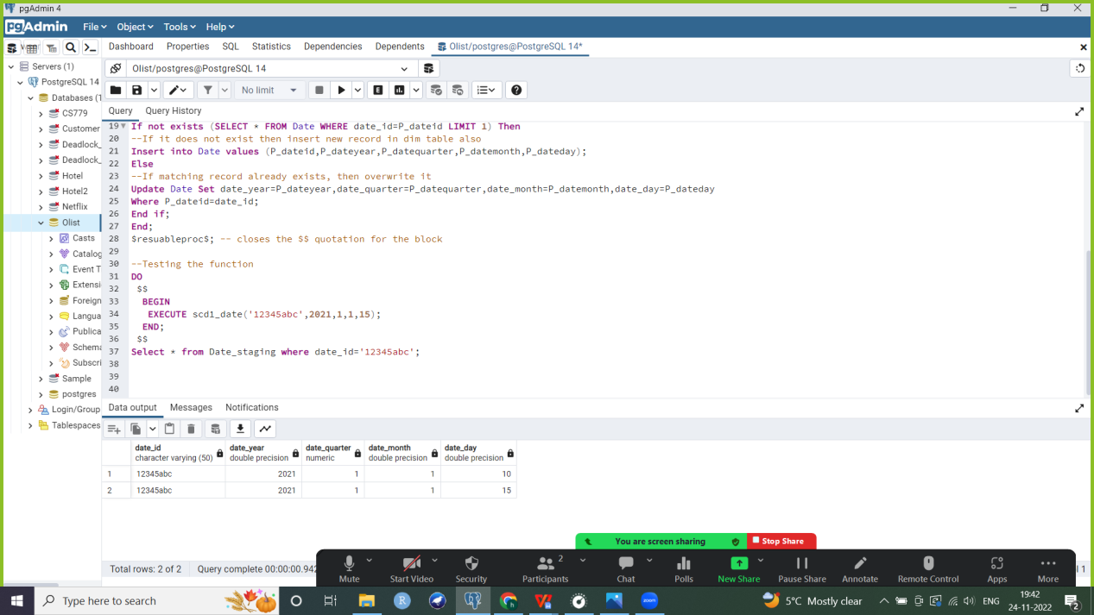
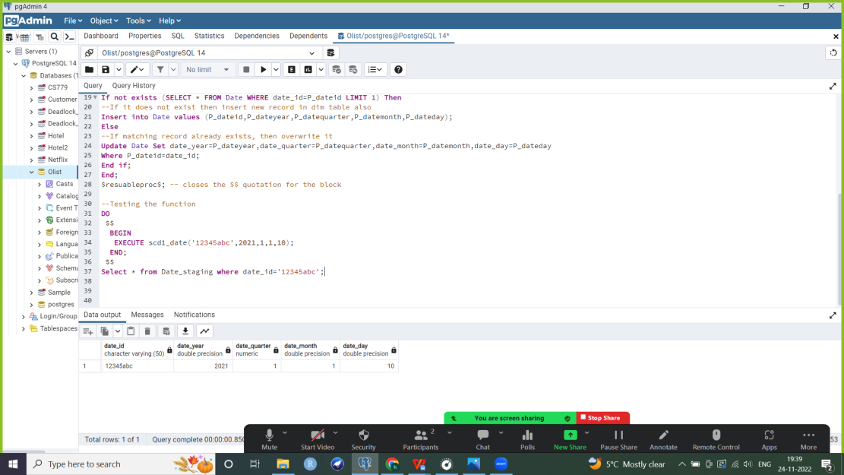


Maintaining SCD1: Date
Testing the function
Case 1: Record does not match
DO
$$
BEGIN
EXECUTE scd1_date('12345abc',2021,1,1,10);
END;
$$
Select * from Date_staging where date_id='12345abc’;
--record inserted in staging table
Select * from Date where date_id='12345abc';
--record inserted in dimension table
Case 2: Record does match
DO
$$
BEGIN
EXECUTE scd1_date('12345abc',2021,1,1,15);
END;
$$
Select * from Date_staging where date_id='12345abc';
--record inserted in staging table
Select * from Date where date_id='12345abc';
--record updated in dimension table

Slide 23
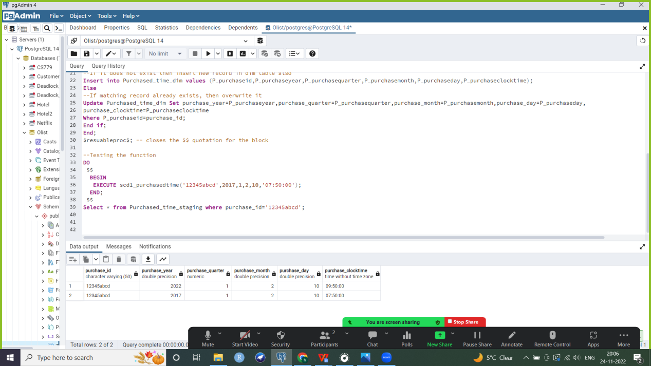



Maintaining SCD1:Puchased time dimension
Case 2: Record does exist
DO
$$
BEGIN
EXECUTE scd1_purchasedtime('12345abcd',2017,1,2,10,'07:50:00’);
END;
$$
Select * from Purchased_time_staging where purchase_id='12345abcd’;
--record inserted in staging table
Select * from Purchased_time_dim where
purchased_id='12345abcd’;
--record updated in dimension table
Testing the function
Case 1: Record does not match
DO
$$
BEGIN
EXECUTE scd1_purchasedtime('12345abcd',2022,1,2,10,'09:50:00');
END;
$$
Select * from Purchased_time_staging where
purchase_id='12345abcd';
--record inserted in staging table
Select * from Purchased_time_dim
where purchase_id='12345abcd’;
--record inserted in dimension table

Slide 24
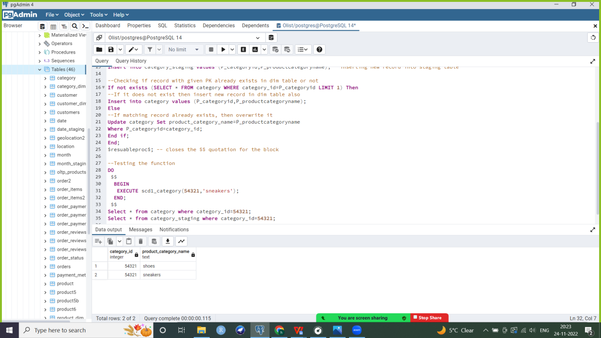

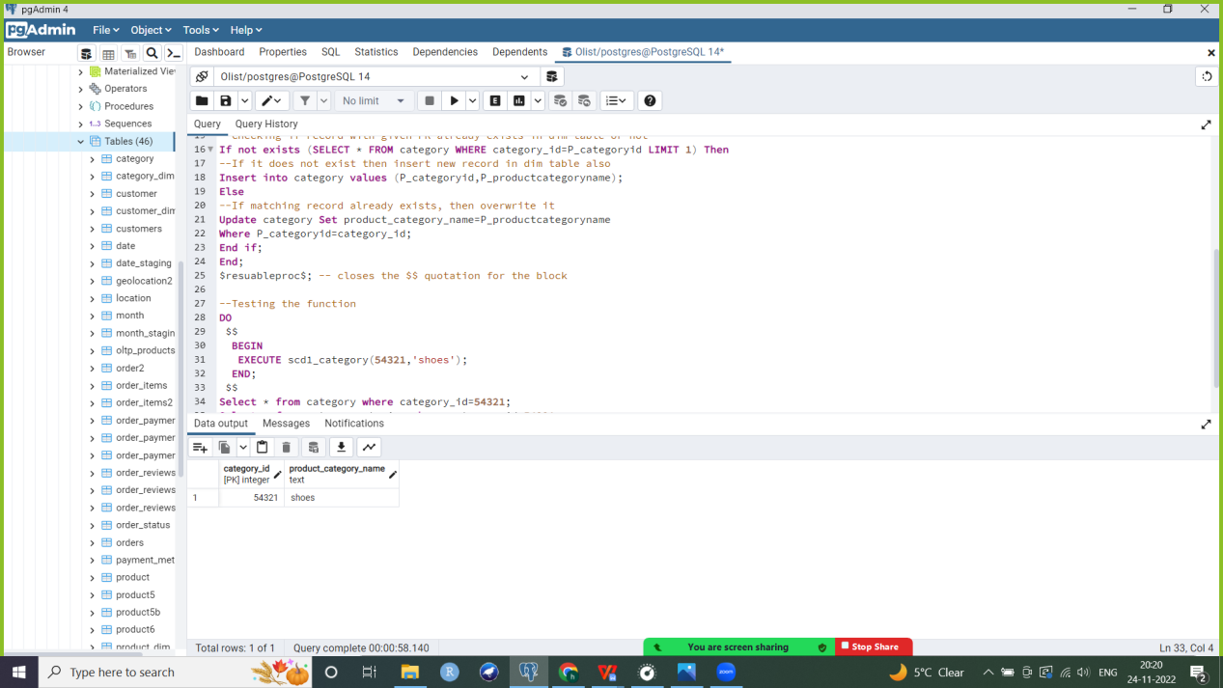

Maintaining SCD1: Category dimension
Case 2: Record does exist
DO
$$
BEGIN
EXECUTE scd1_category(54321,'sneakers');
END;
$$
Select * from category_staging where category_id=54321;
--record inserted in staging table
Select * from category where category_id=54321;
--updating in dimension table: shoes overwritten by sneakers
Testing the function
Case 1: Record does not match
DO
$$
BEGIN
EXECUTE scd1_category(54321,'shoes');
END;
$$
Select * from category_staging where category_id=54321;
--record inserted in staging table
Select * from category where category_id=54321;
--record inserted in dimension table

Slide 25
SCD3: Customer dimension
The customer’s address (including state, city and/or zipcode) changes infrequently and the company wants to store previous and current values of the customer’s address
Adding 3 new attributes into dimension table to record previous values of customer’s state, city and zipcode
Steps:
a. Creating staging table (without PK)
b. Inserting three new attributes into dimension table to record previous values of customer’s state, city and zipcode
Alter table customer_dim add column prev_zipcode numeric(16);
Alter table customer_dim add column prev_customercity varchar(50);
Alter table customer_dim add column prev_customerstate varchar(10);
c. Creating a stored procedure which inserts a new record into the staging table. It then compares if a record with the same PK (customer_id) exists in the corresponding dimension table. If not, it simply inserts this record into the dimension table
d. If matching PK was found, check if each attribute we are tracking previous, current values for has changed or not (zipcode, city and state). If any of them have been modified then update current value to the value we just inserted (used as function parameter) and set earlier value of attribute(s) as previous value

Slide 26
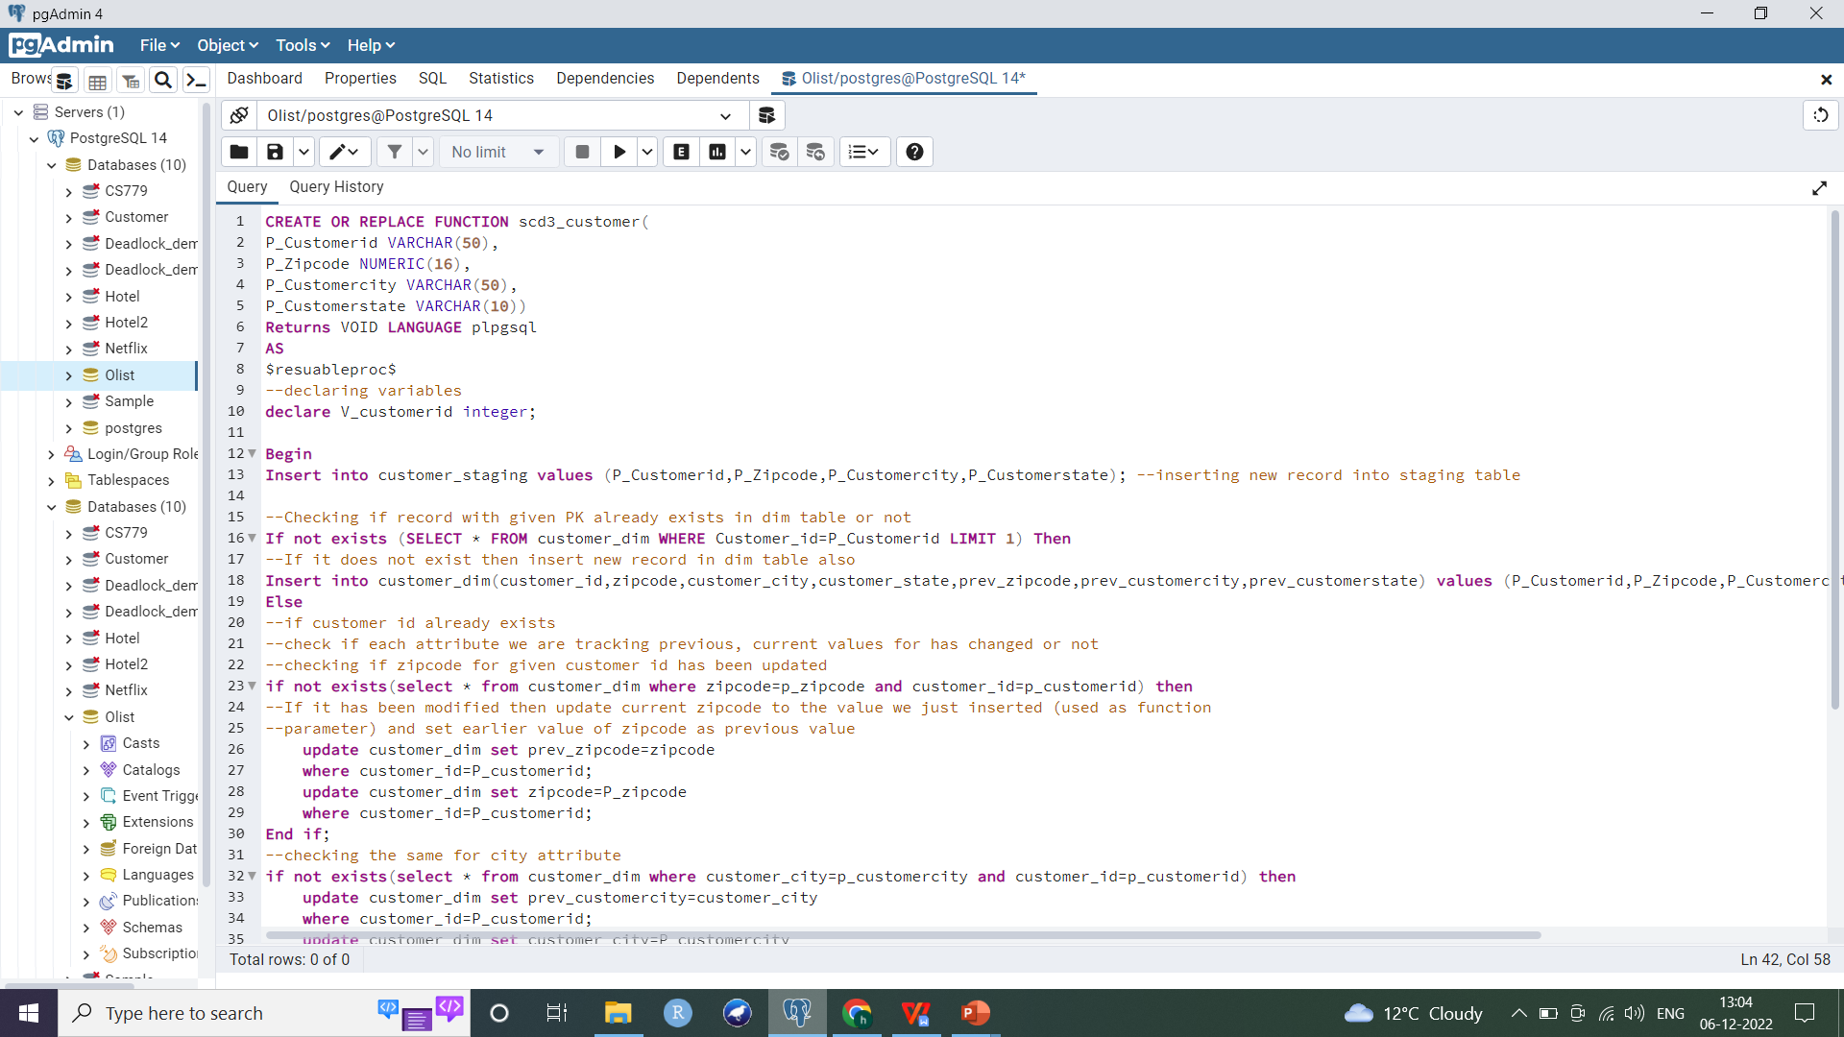
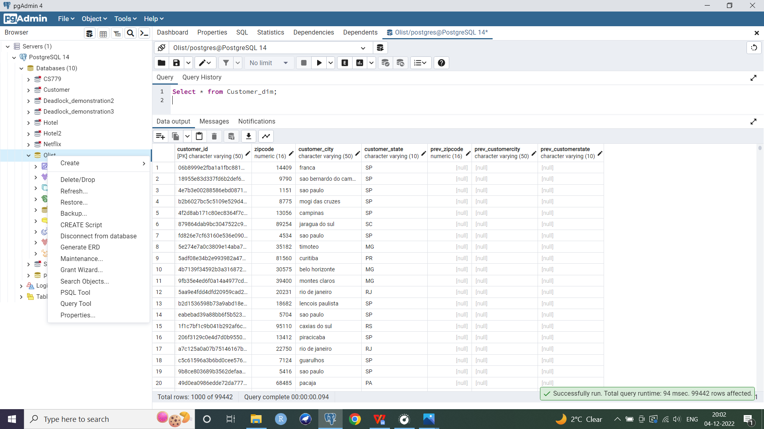
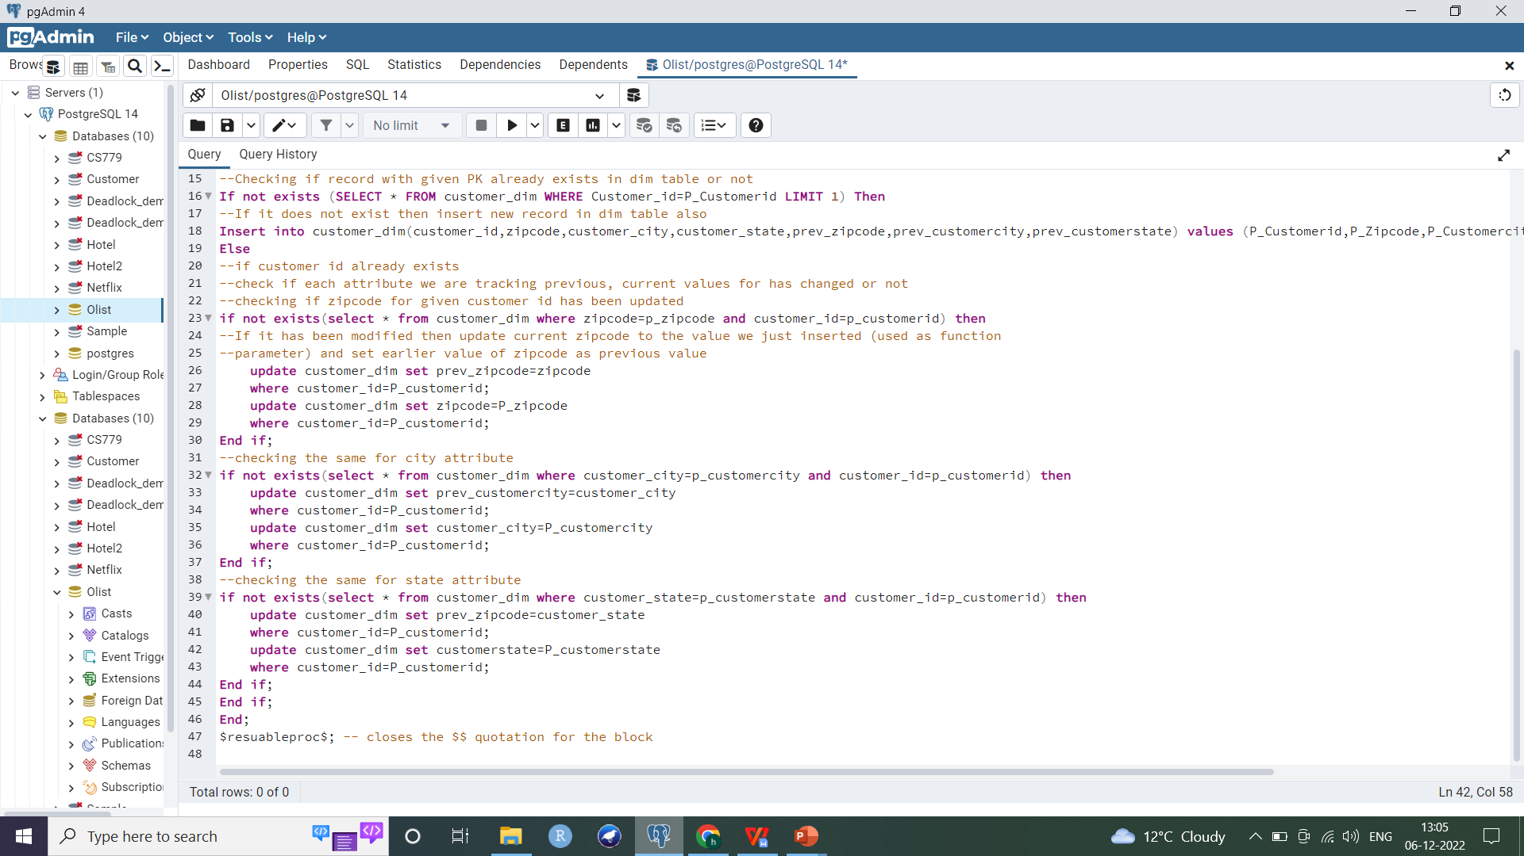
Maintaining SCD3: Customer
Customer dimension (till now the previous values are null since record with
the same composite PK has not been inserted yet)

Slide 27
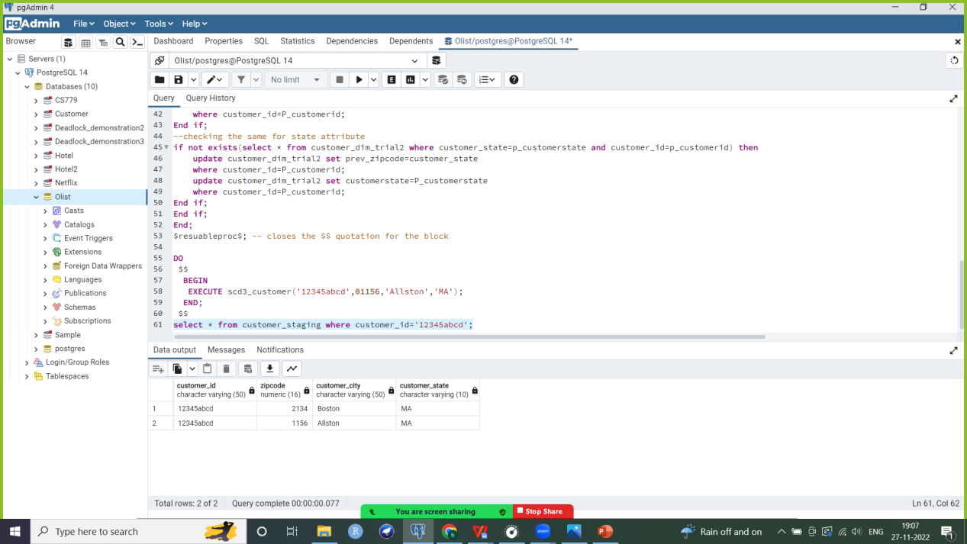
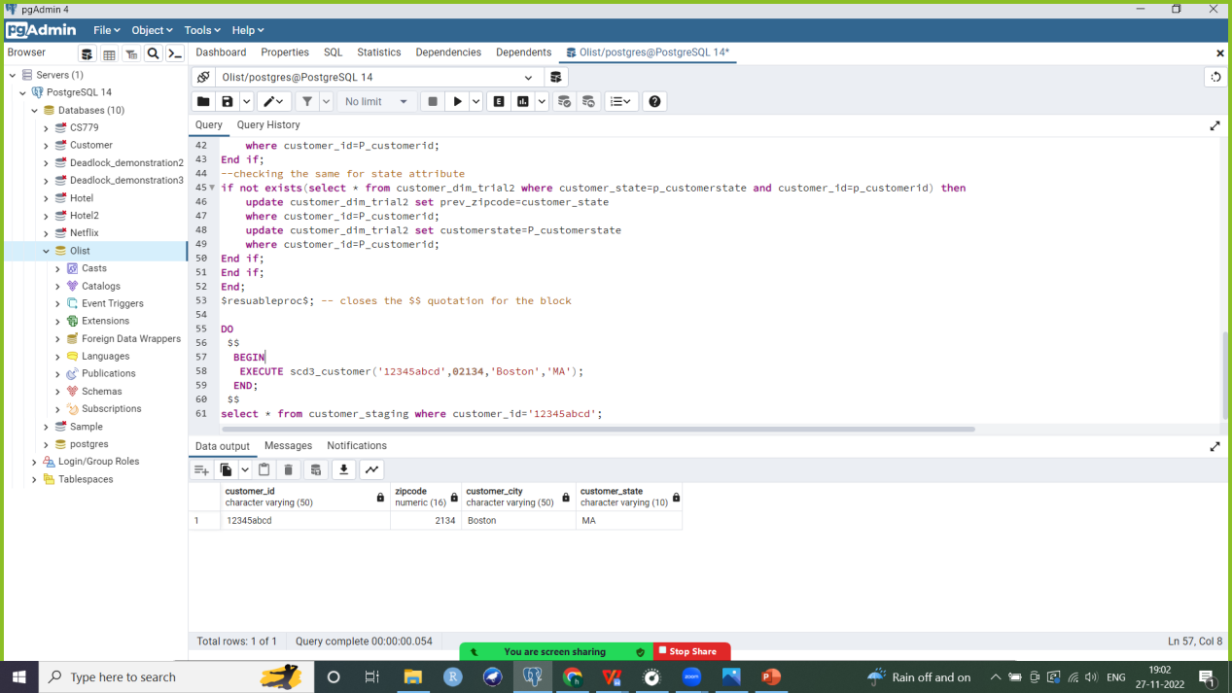
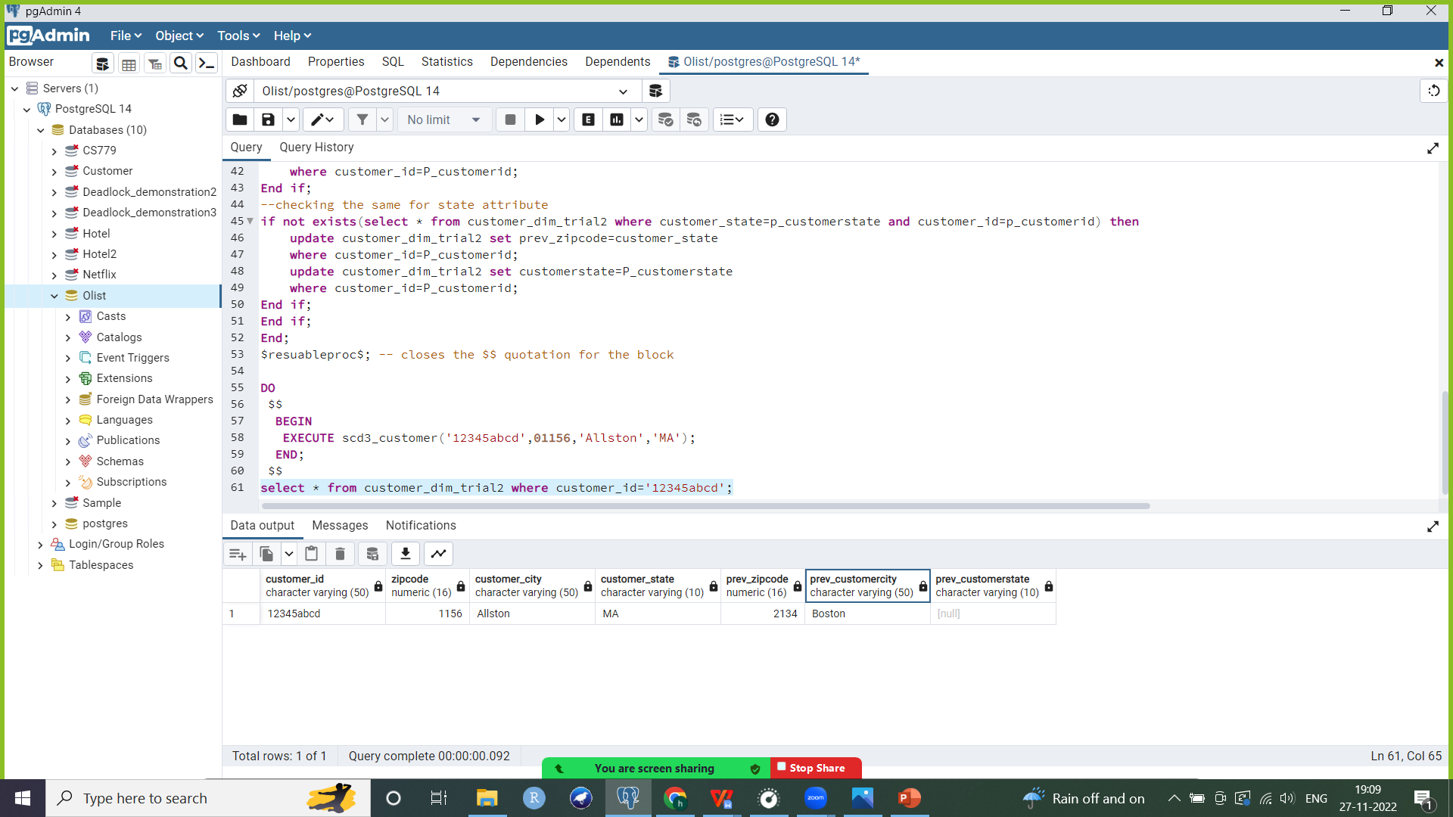
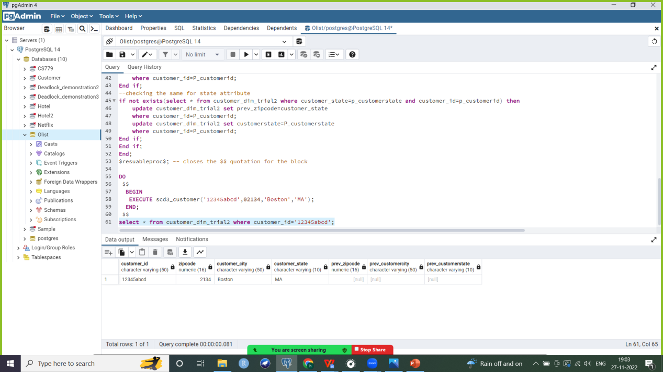
Maintaining SCD3
Case 2: Record does match
DO
$$
BEGIN
EXECUTE scd3_customer('12345abcd',01156,'Allston','MA’);
--zipcode and city values have changed
END;
$$
Select * from Customer_staging where customer_id=’12345abcd’;
--record inserted in staging table
Select * from customer_dim where customer_id=’12345abcd’;
--record updated in dimension table, city and zipcode have previous and current values
Testing the function
Case 1: Record does not match
DO
$$
BEGIN
EXECUTE scd3_customer('12345abcd',02134,'Boston','MA’);
END;
$$
Select * from Customer_staging where customer_id=’12345abcd’;
--record inserted in staging table (staging table does not store previous values; no updates only inserts)
Select * from customer_dim where customer_id=’12345abcd’;
--record inserted in dimension table
--Here previous values are null since record has been inserted for the first time and no values have been updated yet

Slide 28
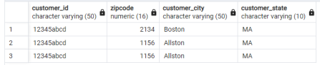
Maintaining SCD3
Testing the function
Case 3:Record exists but no updates have occurred in its attribute values
DO
$$
BEGIN
EXECUTE scd3_customer('12345abcd',01156,'Allston','MA’);
END;
$$
Select * from Customer_staging where customer_id=’12345abcd’;
--staging table now has 3 records associated with customer id ‘12345abcd’
Select * from customer_dim where customer_id=’12345abcd’;
--dimension table remains unchanged

Slide 29
SCD2: Product dimension
Attributes of the product such as height, weight and other dimensions frequently change. Whenever a change occurs, a new record is added to the dimension table and effective, expire timestamps and current flag values are modified accordingly
Steps: a. Creating staging table (without PK)
b. Since product_dim is scd2 and multiple records with same id can exist, I am adding a synthetic PK product_dim_id
Create table Product_dim2 as select * from product_dim;
Alter table product_dim2 add column product_dim_id varchar(50);
CREATE SEQUENCE product_dim_id_seq2b AS INT INCREMENT BY 1 START WITH 1;
ALTER TABLE product_dim2 ALTER COLUMN product_dim_id SET DEFAULT nextval('product_dim_id_seq2b');
UPDATE product_dim2 SET product_dim_id = nextval('product_dim_id_seq2b’);
Alter table product_dim2 add primary key (product_dim_id); --adding PK constraint
c. Adding 3 new attributes: current flag, effective timestamp and expire timestamp to maintain scd2
Alter table product_dim2 add column current_flag boolean;
Alter table product_dim2 add column effective_timestamp timestamp;
Alter table product_dim2 add column expire_timestamp timestamp;
d. Updating values of previous records already in table for these 3 attributes: setting current flag as true, expire timestamp to a future date and effective timestamp as today’s date for all records
Update product_dim2 set current_flag= 'true';
Update product_dim2 set expire_timestamp= '9999-01-01';
Update product_dim2 set effective_timestamp= '2022-11-26';
e. Stored procedure to add record in product dimension table if it does not exist. If record with same product_id already exists and an update has occured, then insert new record with a unique synthetic PK, same product_id, current flag as ‘true’, effective timestamp as current timestamp and expire timestamp set to a future date. Also update previous record with same product_id: set its current flag as ‘false’ and expire timestamp to current timestamp

Slide 30
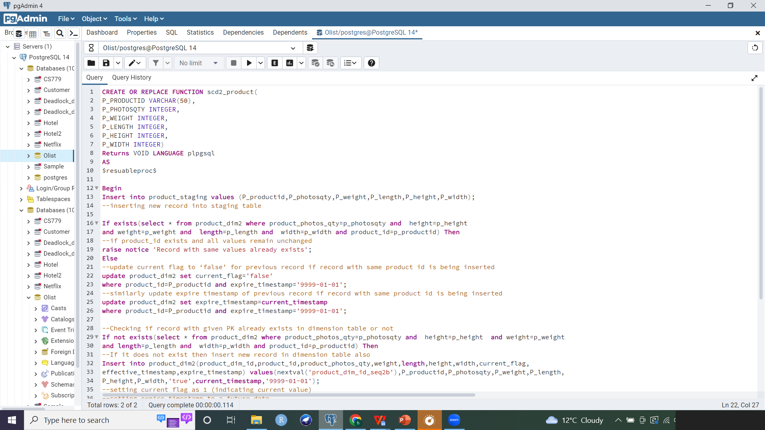
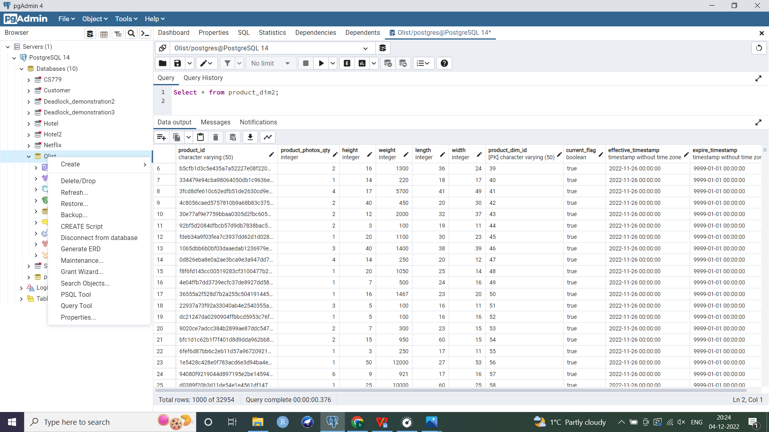
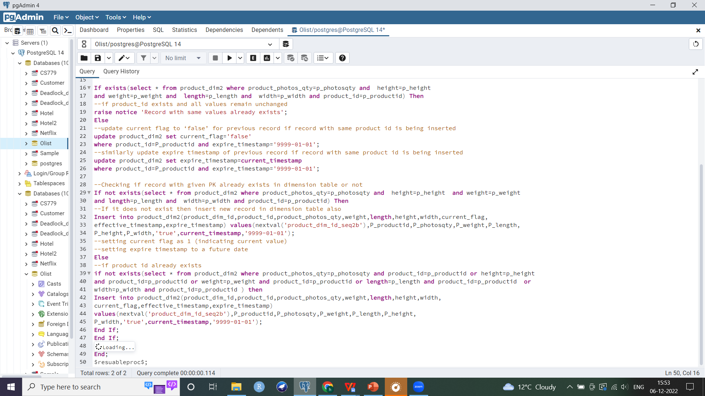
Maintaining SCD2:Product
Product dimension

Slide 31
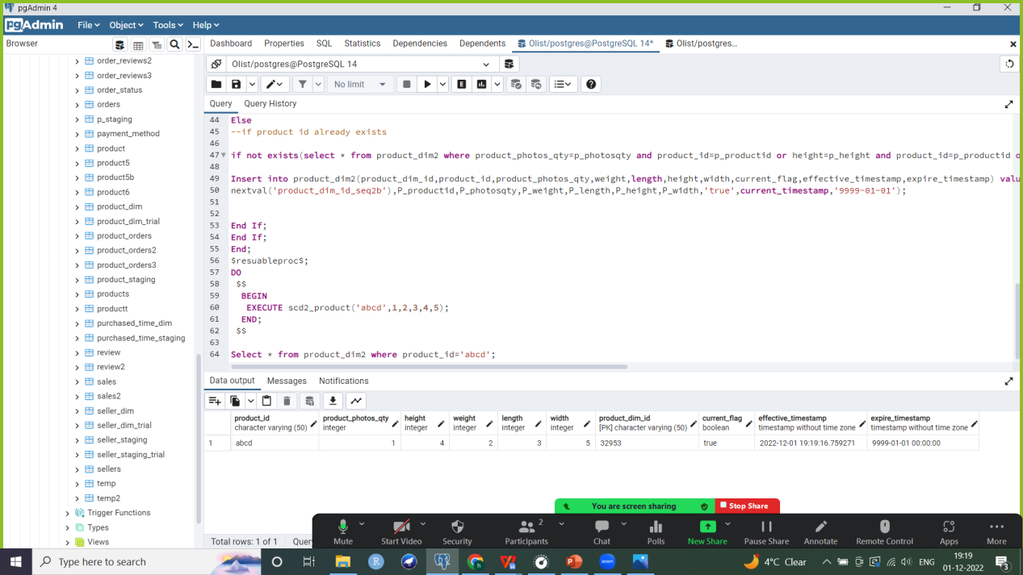

Maintaining SCD2
Testing the function
Case 1: Record does not match
DO
$$
BEGIN
EXECUTE scd2_product('abcd',1,2,3,4,5);
END;
$$
Select * from product_dim2 where product_id='abcd';
--New record inserted in dimension table with current flag as ‘true’, effective timestamp as current timestamp and expire timestamp set to a future date
Case 2: Record does match
DO
$$
BEGIN
EXECUTE scd2_product('abcd',11,12,3,4,5);
END;
$$
Select * from product_dim2 where product_id=’abcd’;
--Record with same product id and new values gets inserted with future date as expire timestamp and current flag set to ‘true’
--Current flag or previous record set to ‘false’ and its expire timestamp is updated to current timestamp

Slide 32
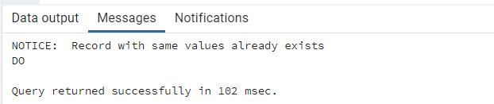
Maintaining SCD2
Testing the function
Case 3:Record with same product_id and no updates (i.e. all values remain unchanged)
DO
$$
BEGIN
EXECUTE scd2_product('abcd',11,12,3,4,5);
END;
$$
--We get a notice that record with same values already exists in the dimension table
Select * from product_dim2 where product_id='abcd’;
--Dimension table remains unchanged

Slide 33
Indexes
1. B-Tree index on the current_flag attribute of the Product dimension table: efficiently searching for most applicable/ latest product details and dimensions (i.e. where current flag is ‘true’)
CREATE INDEX product_current
ON product_dim2 (current_flag);
2. B-Tree index on the purchase_quarter attribute of the Purchased_time dimension: quickly retrieving sales/ revenue for a certain quarter, eliminating the need for a full table scan
CREATE INDEX purchasedtime_quarter
ON purchased_time_dim (purchase_quarter);
3. Multicolumn index for state and city attributes of the Customer dimension table: state used more often for lookups
CREATE INDEX customer_address
ON customer_dim (customer_state,customer_city);
If we search for sales or revenue per state or for a city in a particular state (by joining customer_dim dimension table and product_orders fact table), this index will be used to efficiently scan through the table and retrieve relevant records quickly. However if we search only on the city (i.e. where condition only looks for sales/revenue in a particular city), this index will not be applicable and a full table scan will be used.
Ideally, since current_flag, customer_state and purchase_quarter are attributes with low cardinality (more repeating values), a Bitmap index would be useful. Moreover, Bitmap indexes are more suitable for decision support systems. However Postgresql does not support bitmap indexes, hence I have used a B-Tree index here.

Slide 34
Business questions
1. Finding out the highest selling product category as well as identifying under performing product categories in order to make informed decisions on which products should be dropped or marketed more.
2. Finding out which quarter had the highest revenue to understand what factors contributed to a higher earning in that quarter (for example, quarter 2 could have a higher revenue because of summer sales). Further looking at top 10 best selling product categories in this highest earning quarter to make business decisions on marketing these products during peak season.
3. Observing trend in total revenue across all 3 years the company has data for (2016 to 2018).
4. Analyzing average review scores per month. This can be used to understand customer sentiments throughout the year (for example, checking if ratings are higher during the holiday season, etc.).
5. Analyzing average review scores per quarter across all 3 years. For example, if the company launched a new product, it might be useful to look into ratings during this period.

Slide 35
Business Questions
6. Inspecting total earnings per product category by sellers across all cities to identify best selling product categories from each city (i.e. sellers from a particular city had highest revenue for which product category) as well as examine where each product category is most popular or which city houses the highest earning sellers for a given category of products (sellers from which city earned most from sales of this product category). This could be useful for investing in courier/delivery services to high performing geographical locations.
7. Evaluating how sellers from various states are performing and which state houses the best sellers. Further understanding products of which category are most popular from sellers of various states. This can be used to reward the top performing seller states by providing incentives such as hosting a conference in that state, etc.
8. Observing if there is an association between the number of product photos that a company has put up on their website and product ratings. For example, higher number of photos leading to higher expectations by the customer, thus leading to a lower rating. This can then be used to increase or decrease the number of product photos.
9. Examining the revenue and number of products sold/ sales per month, and analyzing if these measures are correlated. For example, does the price of each product play a greater role than the number of products sold in contributing toward total revenue?
10. Identifying geographical areas which are generating the highest revenue. This can be helpful in implementing location based advertisement strategies.

Slide 36
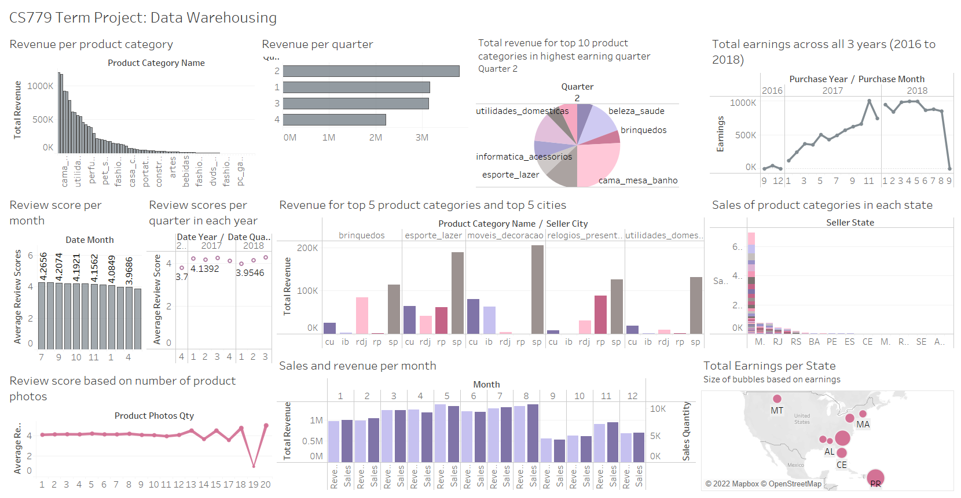

Slide 37
Answering Business Questions: Tableau Analysis
1. Beleza saude (or beauty health) was the highest selling product category. Seguros e servicos (insurance and services) was the lowest selling product category.
2. Quarter 2 was the highest earning quarter. In this quarter, cama mesa banho (or bed table bath) was the best selling product category, followed by beleza saude (beauty health).
3. 2017 saw a steady rise in revenue. Earnings were quite high and remained consistent for most part of 2018 except a sudden drop in September.
4. Product ratings were highest in July (average of 4.26), followed by August and September.
5. Product ratings were consistently higher in 2017 as compared to 2016 and 2018. Both in 2017 and 2018, quarter 3 had highest product ratings.

Slide 38
Answering Business Questions: Tableau Analysis
6. To analyze revenue per product category by sellers from various states, I used the top 5 states and top 5 product categories (based on total revneue) for the purpose of my visualization. We can see from the grouped barplot that sellers from Curitiba (Cu) and Ibitinga (Ib) were most popular/ had highest earnings for moveis decoracao (or furniture decoration). Similarly, best selling product category by sellers from Rio de janeiro (Rdj) was brinquedos (or toys). We can also say that Sau paulo (Sp) had the highest earning sellers for brinquedos/ toys and esporte lazer (or sport leisure), and so on.
7. Sellers from Sau Paulo (SP) state had highest number of sales. These sellers were most popular for cama mesa banho (or bed table bath) products. The next best sellers were from Minas Gerais (MG) and their sales were highest for informatica acessorios (or computer accessories).
8. The number of product photos the company uploads does not seem to have an impact on customer ratings.
9. Revenue was highest in the month of May, followed by August. On the other hand, number of sales were highest for August, followed by May. Could increasing product prices in August further increase revenue during this month?
10. Highest revenues were generated by PR (Parana) and SC (Santa Catarina).

Slide 39
Challenges faced
I first created dimension and fact tables, and then focused on slowly changing dimensions and how they can be maintained
Since product dimension is scd 2, I added a new synthetic primary key product_dim_id to maintain it. Thus all fact tables which referenced product dimension table (product_orders and sales) had to be updated to reference product_dim_id as a FK instead of the previous product_id (which can be duplicated in my scd2 product table)
2 fact tables had to be updated which had product_id as their FK,PK. I replaced this with product_dim_id which is the synthetic PK for my product dimension table (since it was introduced to maintain scd2)

Slide 40
What I learned
Normalization and difference between schema of operational database vs data warehouse
Extract, Transform, Load operations: how companies can extract data, transform it into a denormalized schema with dimension and fact tables(s), and load data into staging and dimension tables based on slowly changing dimensions
Constellation Dimensional Schema: when it might be useful to have time dimensions at different levels of granularity, use cases of cumulative and snapshot fact tables
Slowly changing dimensions: when to use each type and how to maintain them
Revised the use of subqueries, joins, aggregates, window functions, stored procedures, etc.

Slide 41
References
https://aws.amazon.com/blogs/big-data/implement-a-slowly-changing-dimension-in-amazon-redshift/
https://www.timescale.com/blog/postgresql-vs-python-for-data-cleaning-a-guide/
https://www.postgresql.org/docs/current/functions-datetime.html
https://www.postgresqltutorial.com/import-csv-file-into-posgresql-table/
Lecture Notes

Slide 42
Thank you.

